Slide 1

Preeclampsia Scenario with HELLP & Eclampsia Complications
D. Berrin Gunaydin, MD, PhD
Ankara, Turkey
www.berringunaydin.com

Slide 2
Case presentation
38 yr old nulliparous at 33¹ weeks’ gestation
67 kg & 161 cm
Symptoms Headache, epigastric pain, blurred vision, nausea-vomiting & dizziness
Vital signs
  BP:190/110 mmHg HR:102 beat/min RR:22 breath/min Temperature: 37.1°C
Physical exam
  Bilateral + pitting edema in lower extremities

Slide 3
Initial medical treatment
IV bolus of 5 mg hydralazine over 2 min
IV 5 mg hydralazine repeated after 20 min
Blood pressure (BP) decreased to 170/110 mmHg
IV bolus 20 mg labetalol over 2 min
BP:160/90mmHg, 96 beat/min & 16 breath/min
Betamethasone 6 mg IM (twice)
Continuous cardiotacography monitoring provided
Notes:
Despite OGYNs started labetolol……………BP was still 170/110 mmHg
BP a bıt stabılızed

Slide 4
Urine and blood tests
Urine Protein ++ | 1 g/day
Urine – P/C (protein/creatinine) | 162.32/219.01 = 0.7
Hb | 9.1 g/dL
Platelet | 52,000/µL
AST | 331 U/L
ALT | 116 U/L
LDH | 1524 U/L
Albumine | 2.6 mg/dL
Total bilirubin | 1.2 mg /dL
Indirect bilirubin | 0.2 mg/dL
BUN | 15 mg/dL
Creatinine | 0.8 mg/dL
Coagulation tests
PT | 12.3 sec
PTT | 43.2 sec
Fibrinogen | 2.6 g/L
While planning her expectant management
she had a grandmal seizure
Notes:
Laboratory tests on admission
What is the most likely reason for seizure?
Ofc the most lkely reason for grand mal seizure is ECLAMPSIA!!!!!!!!!!!!

Slide 5

Preoperative Evaluation
Standard Monitorization
ECG: NSR
HR: 96 beat/min
BP: 160/90 mmHg
Sp0₂: 98%
RR: 16 breath/min
IV bolus MgSO₄ 4 g in 20 min followed by 1 g/h IV infusion
12 h fasting
ASA III-E
Airway exam: Class II Mallampati
RL infusion 200 mL/h
Notes:
After confirming the diagnosisi of SPE complicated with eclampsia and HELLP, OBGYNs strated mg infusion …
How should it
be managed?
(difficult airway risk may result from soft tissue edema due to fluid retention, increased permeabilty,
low plasma oncotic presure)

Slide 6
Management
General
Anesthesia
First left lateral tilt
After cord clamping IV oxytocin infusion started
Newborn with Apgar scores 8 and 9, at 1 & 5 min
Operation lasted 35 min
Residual neuromuscular block antagonized by neostigmine & atropine
Induction
After preoxygenation
IV propofol and rocuronium with RSI
For blunting response to laryngoscopy
IV bolus 5 mg labetalol
IV 1.5 mg/kg lidocaine
Maintenance
Sevoflurane 0.75 MAC in 50% NO₂/O₂ mixture
Notes:
10 IU OF OXYTOCIN INFUSION IN 500 ML RL SOLUTION…BECAUSE FLUID RESTRICTION IS IMPORTANT

Slide 7
Follow up
Postoperative
Care
Patient was told to report any signs/symptoms after discharge at home as well
Postopretaive multimodal analgesia
IV MgSO₄ continued for 24 hours
BP monitored 72 hours at the hospital
Discharged on postoperative 4 day
Notes:
According to some epidemiological studies, a dose dependent relationship was shown between preeclampsia and long term cardiovasscular morbidity and mortality. Specifically, early onset severe preeclampsia is assoc,ated with heart failure (left ventricular dysfunction/hyperthrophy)

Slide 8
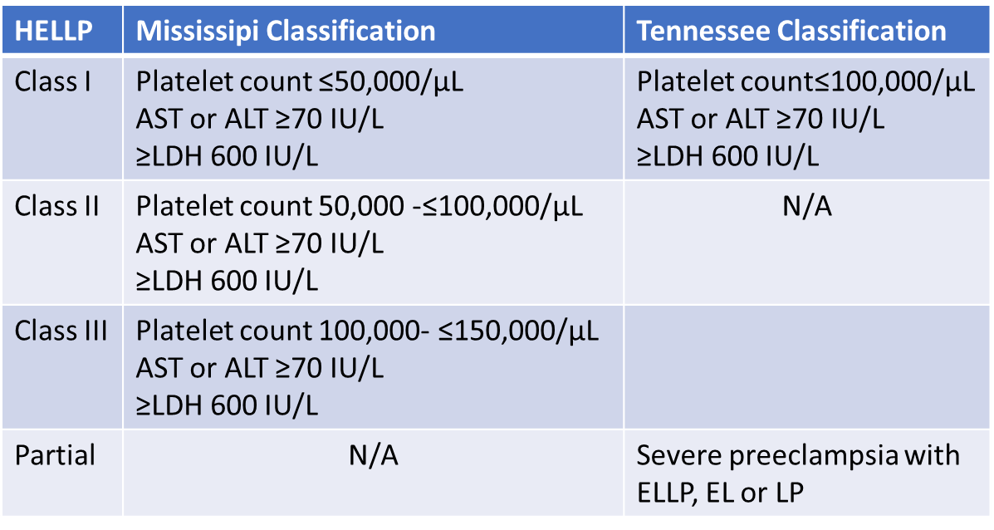
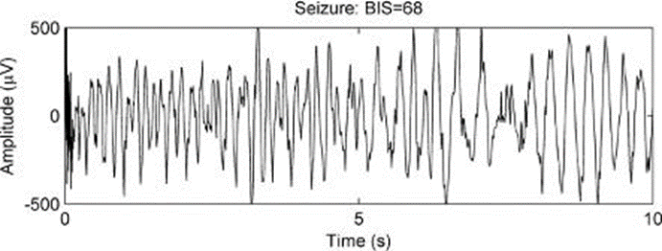

Severe Preeclampsia
BP ≥ 160/110 mmHg
Platelet count 52,000/µL
AST 331 U/L
ALT 116 U/L
LDH 1524 U/L
Eclampsia
Seizure (+)
Diagnosis confirmed
Notes:
SPECTRUM OF SEVER PREECLAMPSIA
Borderline Class I

Slide 9
Pathophysiology and Prevalance
Overall incidence of HELLP is 2-12% of all pregnancies
20% of preeclamptic women with severe features develop HELLP
Notes:
Rougly overall incidence of HELLP is 2-12% of all pregnancies in the WORLD.

Slide 10

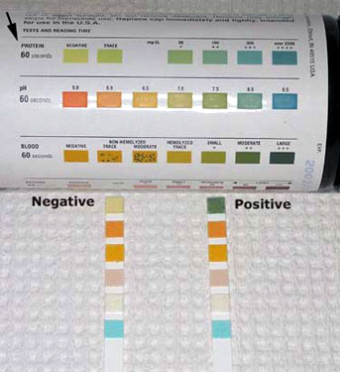
New terminology
After 20 weeks gestation BP treshold on 2 occasions with ≥ 4 h apart
if BP ≥ 140/90 mmHg for mild preeclampsia
İf BP ≥ 160/110 mmHg for severe preeclampsia
Hypertension
Proteinuria
≥ 300 mg/24 h in urine or Urine P/C ratio >0.3
Edema
Obstet Gynecol Clin N Am 2017:44:219-30
Notes:
1st of all edema has been removed after revision
Secondly, Proteinuria: 300 mg/24 hour is sufficient but NOT necessary for diagnosis of preeclmapia any more.
Urine P/C ratio >0.2 is sound!!!!!!!!!!!

Slide 11
Cesarean
Platelet transfusion if <50,000/µL before CS
Spinal is an appropriate choice
General anesthesia
Continue MgSO₄ infusion
Smaller ETT tube
Blunt hemodynamic response to intubation
Labor
Neuraxial techniques are appropriate as long as platelet function/count are adequate
Early catheter placement
Checking platelet count before catheter removal
Platelet transfusion if < 20,000/µL before or after delivery
Anesthetic Management:
General Principles

Slide 12
Labetalol
IV bolus 5 or 10 mg
(avoid in asthma)
1
Remifentanil
IV bolus 1 µg/kg
2
Lidocaine
IV bolus 1.5 mg/kg
3
Esmolol
IV bolus 1 mg/kg
?
Drugs blunting hemodynamic response to laryngoscopy &intubation
Notes:
ESMOLOL was compared wıth one of these drugs alone or ın combınatıon wıth lıdocaıne
In the non-obstetrik population when esmolol+lidokain versus remıfentanıl was comparedi remıfentanil was found to be effective than esmolol
In the pregnancy induced HT 1 mg/kg esmolol + 1,5 mg/kg lidocaine was effective in attenuating adrenergic responses to laryngoscopy and intubation IJOA 2002

Slide 13
General Anesthesia
TIVA - TCI
Induction: Propofol at 4 ng/mL & remifentanil at 3 ng/mL
Neuraxial Anesthesia
Spinal (n=53) vs Epidural (n=47)
Maintenance: Both propofol & remifentanil at 3 ng/mL
Tracheal intubation:Succinylcholine 1.5mg/kg or rocuronium 1.2mg/kg
Severe preeclamptic parturients
Prospective randomized multicenter study
Anesth Analg 2005
Rev Brasil Anestesiol 2016
Anesthesia Essays Res 2017
CSE (n=50) Spinal (n=12) General (n=37)
Platelet (mean) 112,600/µL 95,700/µL 76,800/µL
Clin Exp Obstet Gynecol 2009 (Retrospective study in 102 preterm HELLP)
J Anaesthesiol Clin Pharmacol 2011
Anesth Analg 2013
Notes:
How Could We Manage This Particular severe Preeclamptic Parturient Differently ?
TIVA and/or TCI might be an option for general anesthesia!!!!!!!!!!!!
BIS monitoring is considered regarding TCI but t is not a MUST or a standard monitoring tool for general anesthesia of severe preeclamptic patients!!!!!!!!!!!!!!!!

Slide 14
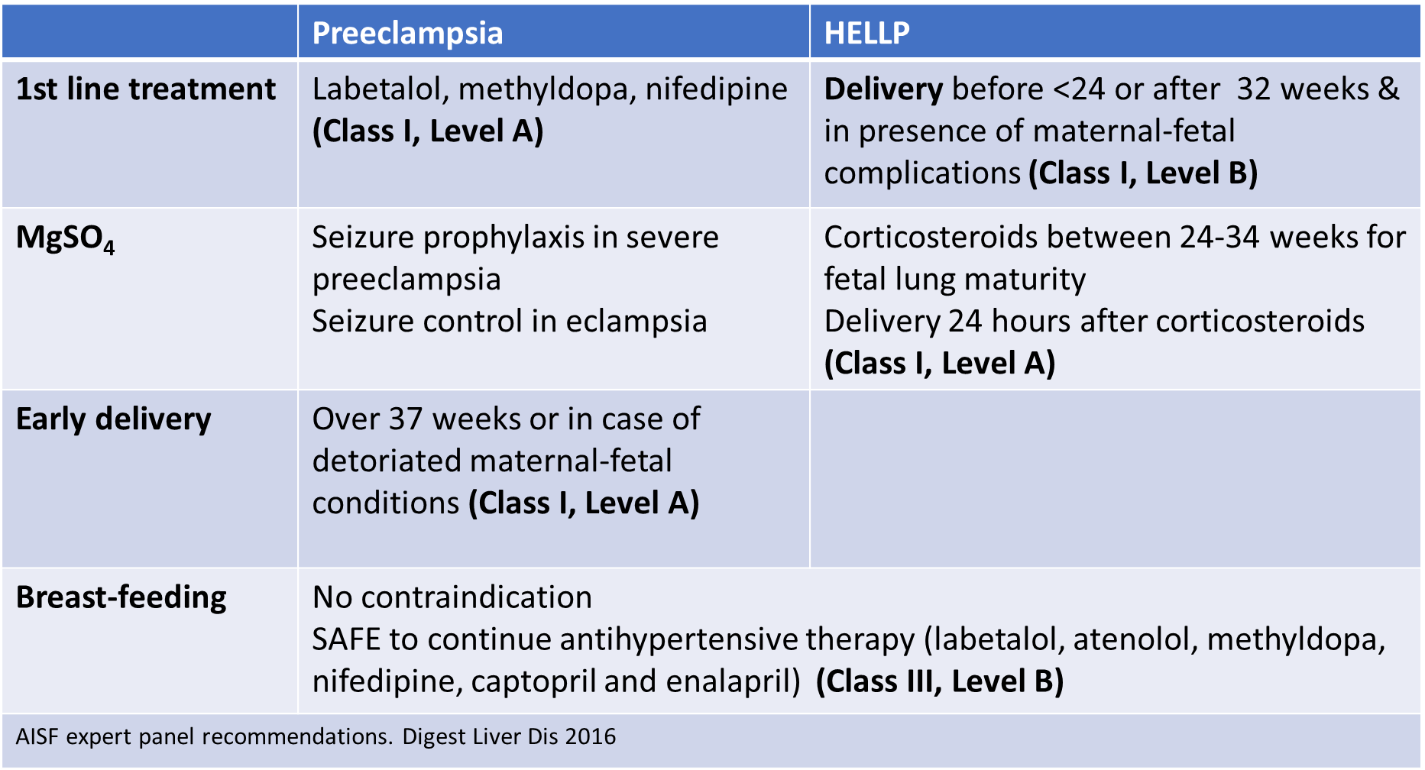

Delivery at 37 weeks
34-37 weeks optimum time to prevent maternal/neonatal morbidity is unknown
<34 wks’ elective delivery is NOT considered
Notes:
Optimal timing of delivery is challenging…...

Slide 15
Methyldopa
Diazoxide
Labetalol
Hydralazine
Nifedipine
Peripartum
AVOIDED
SAFE
Atenolol
ACE inhibitors
AT type-2 receptor antagonists
(FDA Category C)
 | Preeclampsia and/or HELLP
Breast-feeding | No contraindication SAFE to continue antihypertensive therapy (labetalol, nifedipin, atenolol, enalapril, captopril, methyldopa) Class III Level B
Antihypertensive drugs
Crit Care 2016
Obstet Gynecol N Am 2017
Notes:
TARGETTING TO CONTROL BP WITHIN 1 HOUR IS STRONGLY ADVISABLE!!!!!!!!!!!!!!!!Labetalol,Hydralazine and Nifedipine are FDA Risk category C drugs.
Atenolol is avoided because it causes fetal retardation.

Slide 16
Invasive continuous intraarterial BP monitoring is indicated
in cases with poorly controlled HT
rapid need for lowering BP
for frequent use of blood gases
Central venous pressure monitoring is advisable
for assessment of oliguria and its response to fluid administration
Non-invasive modalities of haemodynamic measurement such as;
lung ultrasound, transthoracic echocardiography or pulse waveform monitors
Monitoring
FHR/Uterine contractions
Notes:
However, there is no specific indication for preeclampsia!

Slide 17
MgSO₄ is 1st line drug for
prevention of seizures in preeclampsia & ongoing seizures in eclampsia
IV bolus loading dose
4-6 g/100 mL saline over 20 min
IV maintenance dose
1-2 g/h infusion
Adverse effects
Hypotension, arrhythmias, respiratory depression, flushing nausea-vomiting, drowsiness, slurred speech, double vision...
Prevention-treatment of seizures
Notes:
ACCORDING TO WWW.UPDATEANESTHESIOLOGISTS.ORG...... Maintain adequate airway, oxygenation, restraining gently as needed and inserting a padded tongue blade sımultaneously with Mg treatment
.........
Even. MgSO4 is infused in a IV pump to restrıct fluid overload!!!!!!!!!!!!!!!!!!!!!
Serum Mg level greater than 2.7 mg/dl
If serum Mg greater than 7 mg/dl weakness and loss of tendon reflexes and paralysis
If serum Mg greater than 10 mg/dl hypotensıon cardıac arrhythmias occur
Combined IV plus Im regimen (4g/100ml over 20 minutes + 2.5 g IM to each buttocks (max 9 mg in total).
Also do not exceed 9 g of total IV within 1st 1 hour.
Mg is not an antihypertensive . It has severe features for neuroprotection when delivery is expected.
Combined IV and IM regimen
4 g/100 mL saline over 20 min + 2.5 g IM to each buttock
Beacuse of the dose dependent potential adverse effects, serum magnesium levels are suggested to be checked every 4 hour

Slide 18
Phenylephrine (α1)
Ephedrine (β1,β2 and weak α)
Noradrenaline (α1, β)
50 µg/mL IV bolus
5-10 mg/mL IV bolus
5 µg/mL IV bolus
Optimum initial dose
Target BP
Automated computer controlled systems
(bolus and/or infusion)
Vasopressors
Notes:
According to the recommendations for best clinical practice, Kinsella and coworkers, APROPHYLACTIC VASOPRESSOR INFUSION MAY NOT BE REQUIRED since women with preeclampsia develop LESS HYPOTENSION AFTER SPINAL ANESTHESIA than healthy women.
Left lateral uterine displacement should be used in addition to vasopressors!!!
Ngan Kee found a dose ratio of 1:17 for NA/Phenylephrine. ED90 for NA.5.8 microg.

Slide 19
SAFE
AVOIDED
Oxytocin (bolus and/or infusion)
  ED₉₀=0.35 IU or 2.99 IU
  ‘’Rule of threes’’ for infusion
  t_{1/2} elim ≅ 4-10 min
Methergin
Ann Fr Anesth Reanim 2010
Carbetocin
  IV bolus 100 µg
  t_{1/2} elim ≅ 20-30 min
Uterotonics
Notes:
18 women with severe preeclampsia were continuously monitored using both invasively and using lidcoplus monitor (CO; SV, SVR) during spinal anesthesia for CS in Oslo university. Bolus IV 5 IU of oxytocin was administered after delivery,
Methergine is contraindicated!!!!!!!!!!!!!!
Rules of 3s: (3ml/h)
Standart care: 30IU/500 ml
Biz 10 IU/500 mL veriyoruz

Slide 20

MOST recent studies in severe preeclampsia
Airway management
Fluid management
Use of vasopressors
Use of colloid preload + vasopressors
Notes:
NOW I WOULD LIKE TO TOUCH A BT OF MOST RECENT STUDIES TARGETTING SEVERE PREECLAMPSIA

Slide 21
Airway Management
Mallampati | Severe Preeclamptic (n=25) | Normotensive (n=25) | p
T1 Pre-delivery | Mallampati grade (I/II/III/IV) Neck circumference (cm) Thyromental distance (cm) |  | >0.05
T2 Post delivery
T3 Postpartum 24-48 h
USG measurement of airway dimensions | Severe Preeclamptic (n=25) | Normotensive (n=25)
 | 1.Anterior soft tissue at HYOID (median) |  |  | p
T1 Pre-delivery T2 Post delivery T3 Postpartum 24-48 h | 0.70 cm 0.76 cm 0.75 cm |  | 0.58 cm 0.64 cm 0.63 cm | 0.04 0.05 0.05
T1, T2, T3 | 2.Anterior soft tissue at VOCAL CORDS (cm) |  |  | >0.05
T1, T2, T3 | 3.Tongue thickness (cm) |  |  | >0.05
Notes:
CASE CONTROL STUDY….

Slide 22
Fluid Management
Colloid volume had no effect on HR and CI
Fluid management should be tailored to the individual patient with the aid of non-invasive hemodynamic monitoring if available
Notes:
Restraining IV crystalloid infusion to a maximum of 1 liter is recommended!!!!!!!!!!
IV volume expansion should be avoided
Prerenal oliguria should not be treated with IV fluids

Slide 23
Use of vasopressors
 | Group Ephedrine (n=32) (7.5 - 15 mg) | Group Phenylephrine (n=32) (50 -100 µg) | p
UV PO₂ (kPa) | 2.79 ± 0.68 | 2.39 ± 0.62 | 0.02
Fetal acid base status is independent of whether ephedrine or phenylephrine used to treat spinal anesthesia
induced hypotension in severely preeclamptic patients with non-reassuring FHR tracings
Notes:
Initially 300 ml preload of 6% HES (voluven) rapidly.
The aim of this study to use either E or PE to treat hypotension in severe preeclamptic parturients with non-reassuring FHR tracings undergoing cesaren delivery.
Primary outcome was the UA base excess
2ndary outcomes were UA and UV pH and lactate concentrations, UV BE and Apgar scores.
-Either 7.5 mg E or 50 mcg PE were adminstered tp treat hypotension which was defined as 20% decrease from baseline MAP, if MAP was also less than 110 mmHg (Target value)
-If the target was not achieved after 45 mg of ephedrine and 300 mcg phenyephrine, the alternative vasopressor was used

Slide 24
Use of colloid preload+vasopressors
 | Group Ephedrine (n=10) (7.5 - 15 mg) | Group Phenylephrine (n=10) (50 -100 µg) | Difference | p
SVR change (%) | -1.9 (10.5) | 22.3 (7.5) | -24.2 | <0.0001
CI change (%) | 2.6 (6.0) | -12 (7.3) | 14.6 | <0.0001
Phenylephrine effectively reverses spinal anesthesia induced hemodynamic changes in severe early onset preeclampsia,
if left ventricular systolic function is preserved

Slide 25
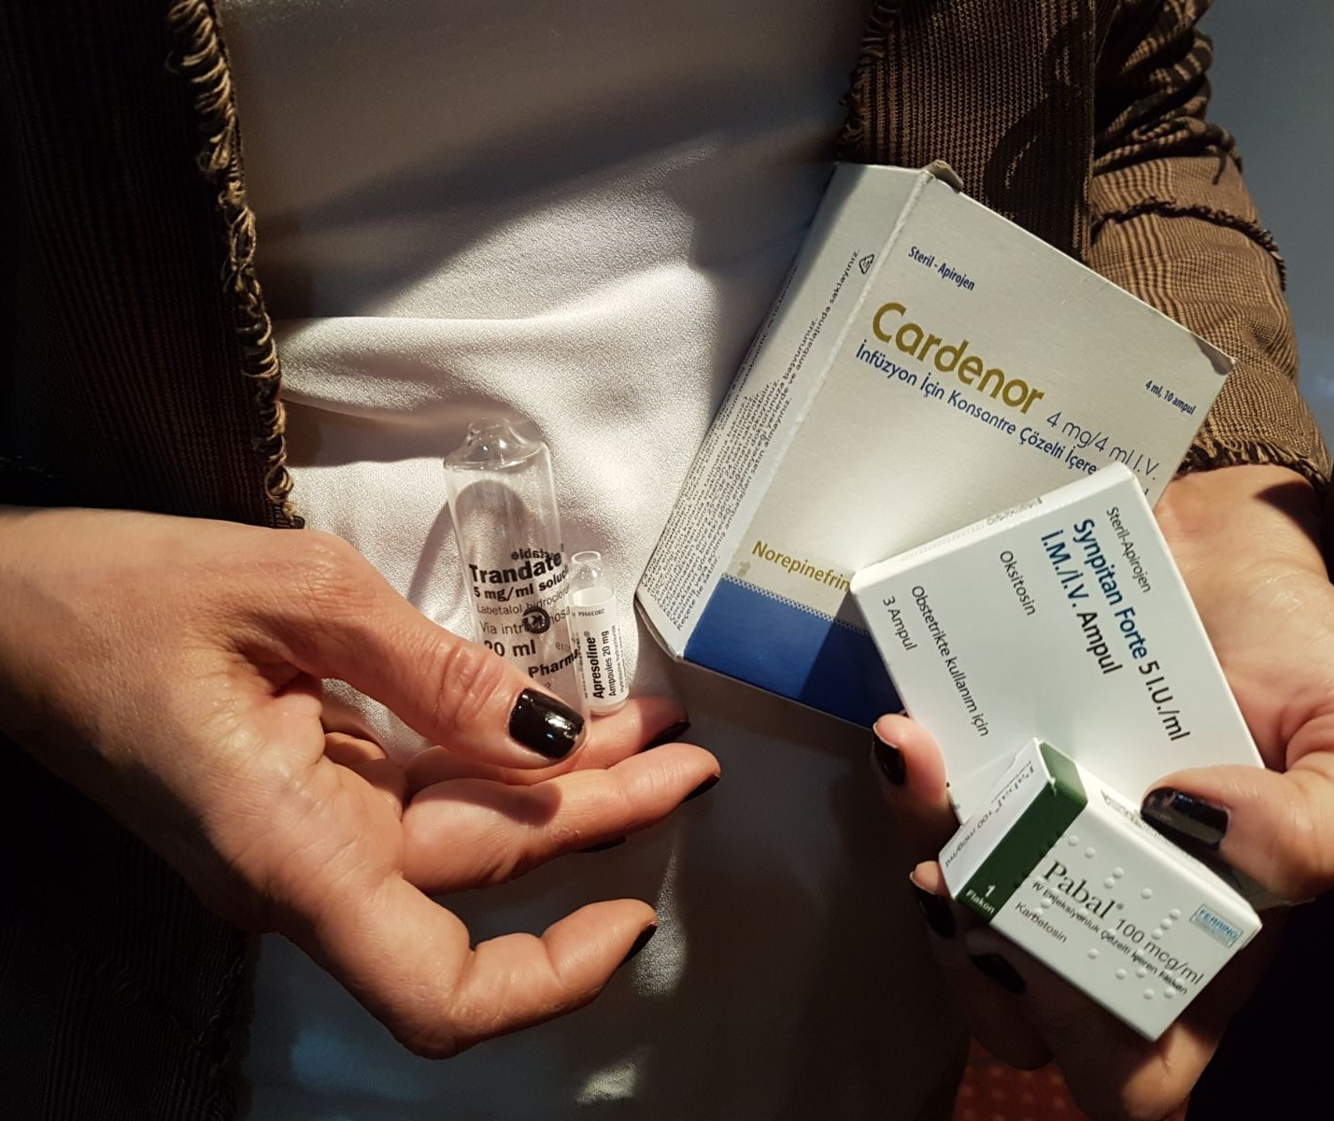
SUMMARY
Control of high blood pressure
Prevention & treatment of seizures
Monitoring (invasive or noninvasive)
Fluid management
Use of uterotonics & vasopressors
Anesthesia options according to coagulation status
Long term ramifications!!!!!!!!!!!!
Notes:
ESSENTIAL
ADVISABLE
UTMOST IMPORTANT
FLUID M. SHOULD BE TAILORED
RATIONAL USE OF ….....

Slide 26
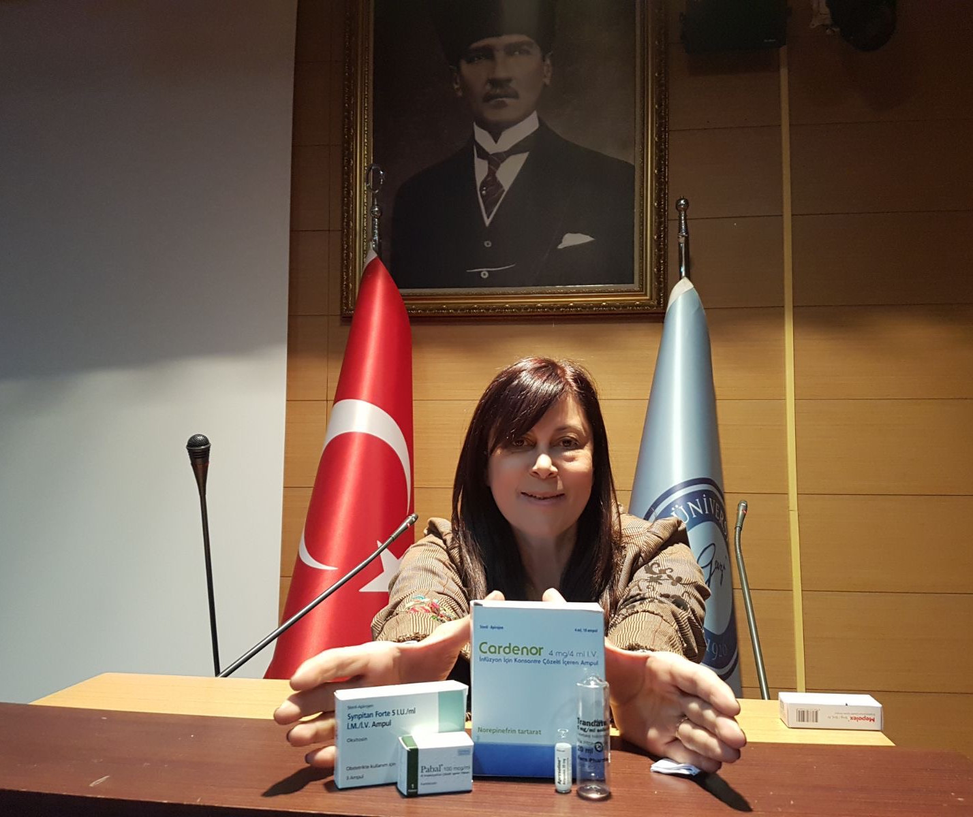
Thank you
Tak Skal du have

