Slide 1

Bleeding Management in Obstetrics : Anesthesiology Perspective
Berrin Gunaydin, Md, PhD
Gazi University School of Medicine
Department of Anesthesiology
Ankara, Turkey

Slide 2
Declaration of conflict of interest
DISCLOSURES and APPOINTMENTS
Chair, Obstetric Anesthesia & Perinatology Subcommittee of Turkish Society of Anesthesiology & Reanimation (TSAR)
Chair, Mother and Child Anesthesia CEEA Modul 4 affiliated by ESAIC and TSAR
Turkish Ministry of Health National PBM Guidelines: Obstetrics & Maternity Module V
Speaker/Course Director of educational activities powered by CSL Behring and NovoNordisk and giganode.org.
Board Member of Gazi University Hospital Blood Bank

Slide 3
PPH rate worldwide
Bleeding management
1st Diagnosis by means of
    Clinical signs
    Measurement or estimation of blood loss
2nd Monitoring
  Hemodynamic
  Laboratory
3rd Management
  Guidelines
  Modified algorithms

Slide 4
PPH is the leading cause for maternal mortality worldwide
Hypofibrinogenemia identified as a major risk factor for progress to severe PPH
Global, regional & national levels of maternal mortality during 1990-2013
Systematic analysis for the global burden of disease study. 2014 Lancet
MMR in Turkey 13.1/100,000 live births in 2021
Annual Health statistics 2021 Issue
Notes:
PPH 16% in turkey

Slide 5
According to ACOG PPH is defined Blood loss ≥ 1 L or hypovolemia signs
1. Diagnosis
Clinical findings
2. Monitoring
Laboratory and Hemodynamic
3. Management
Pharmacologic
Qualitative
Quantitative
Uterotonics
Antifibrinolytic
Non-pharmacological
Interventional Radiology (non-surgical)
Surgical
Sutures
Artery embolization
Balloon tamponade
Artery ligation
Hysterectomy
Procoagulant
Estimation of blood loss
b)Measurement or
Collect blood (20 mL) for
  blood group-type
  full blood count
  coagulation screen including fibrinogen
Monitor & record
  (HR, RR, SpO₂ & BP every 15 min)
  noninvasive cardiac output (if available)
  invasive (arterial/central venous)
Check bladder - insert urinary catheter
Check causes of PPH (4T)

Slide 6
Diagnosis
Clinical Findings in PPH
Notes:
FBC, PT, APTT, fibrinogen; blood‐bank sample, biochemical profile, blood gases or pulse oximetry
Take samples at earliest opportunity as results may be affected by colloid infusion
Ensure correct sample identity -Misidentification is commonest transfusion risk
Repeat FBC, PT, APTT, fibrinogen every 4 h or after 1/3 blood volume replacement - May need to give components before results available
Repeat after blood component infusion

Slide 7
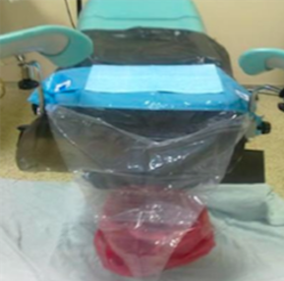
1 gram = 1 mL
Estimated Blood Loss (EBL)
Calculation of blood loss
WET item gram weight – DRY item weight
Equals to ML of blood within the item.
BJOG 2006
Notes:
Coagulopathy risk assessment should include obstetric conditions related to PPH not just EBL.

Slide 8
Hemodynamic
Monitorization
1. Standard
2. Non-invasive
3. Invasive
Shock index = 1
(blood loss ∼20-30%)
Heart rate (HR)
Systolic Blood Pressure (SBP)
(0.9 is normal)
ECG, HR, BP and Obstetric shock index (SI)
Non-invasive cardiac output (if available)
Invasive arterial/central (CVP/PCWP)

Slide 9
Management of Hemodynamics
Maintain normovolemia
Volumes ≥ 4 L of crystalloids & colloids are associated with adverse maternal outcomes
However, restrictive resuscitation of crystalloids vs liberal strategy appears to be equal in mild PPH
Permissive hypotensive resuscitation
(maintain MAP 50-60 mmHg in ongoing bleeding)
Avoid secondary hypervolemia-hypertension, popping effect, that further agrevates coagulopathy
Restrictive (1-2 mL for each 1 mL blood loss)
to avoid dilutional coagulopathy
EJA 2023 Management of severe peri-operative bleeding: Guidelines from the ESAIC 2nd update 2022
EJA 2017 Guidelines from the ESAIC 1st update 2016
Notes:
Correction of acisodsis ALONE cannot ameliorate coagulopathy.
Calcium drops in case of massive transfusion due to citrate induced Ca –binding and shoud be monitored and corrected accordingly in severe PPH. Correction of calcium levels not only optimise coagulation but also uterine muscle contraction (1C).

Slide 10
Coagulation Monitoring
Fibrinogen Monitoring
Standard laboratory
Clauss fibrinogen assay
POC-Viscoelastic tests (VET)
ROTEM/TEG/Clotpro/Quantra
Novel-POC
FibCare
Platelet count (PC)
  Low PC is associated with increased risk of severe PPH, RBC and FFP transfusion
aPTT & PT
  Shows correlation with EBL in PPH
  Critical level of PT/aPPT is not reached in PPH and massive transfusion
Dynamic PC decrease or a level <150,000/µL at the onset of labour, if combined with fibrinogen <2.0 g/L may indicate increased risk of PPH
Eur J Anaesthesiol 2023 Management of severe peri-operative bleeding: Guidelines from the ESAIC Second update 2022
Notes:
In case of 2 L of blood loss
PC is significantly reduced

Slide 11
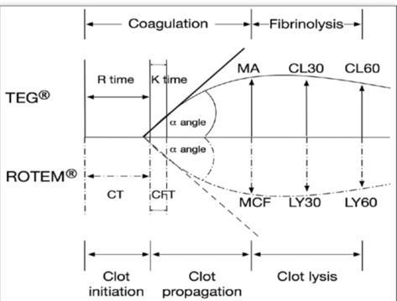
Functional markers of fibrinogen
  TEG - Maximum Amplitude (MA)
  ROTEM - FIBTEM MCF & FIBTEM A5 equally
  associated with morbidity & need for transfusion
  FIBTEM MCF is significantly reduced in PPH
When do we need to evaluate fibrinogen?
  At the onset of labor is less predictive
  During amniotic fluid embolism with DIC, placental abruption, preecclampsia with hemorrhage are of important value
Eur J Anaesthesiol 2023 Management of severe peri-operative bleeding: Guidelines from the ESAIC Second update 2022

Slide 12
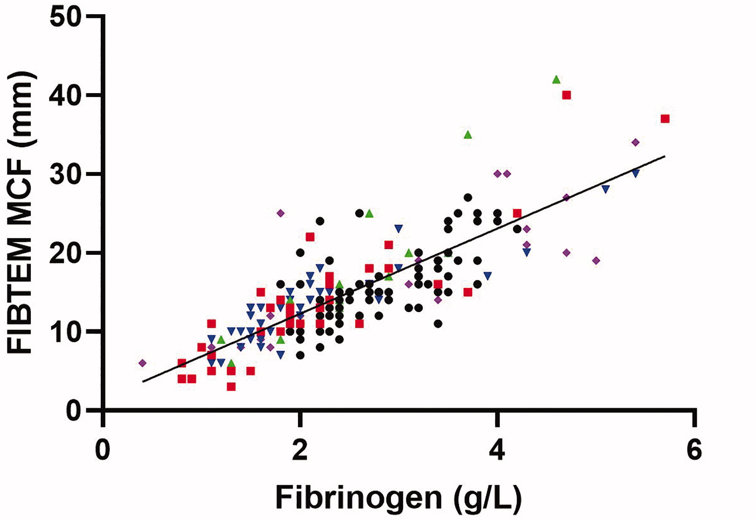
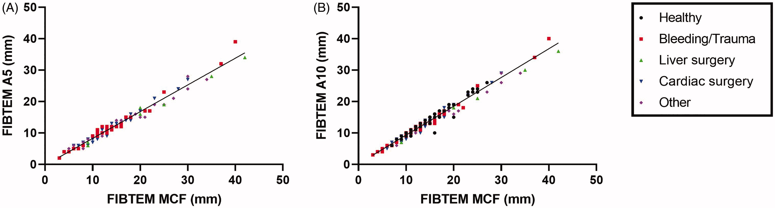
FIBTEM clot firmness parameters correlate well with the fibrinogen concentration measured by the Clauss assay in patients and healthy subjects.
Scand J Clin Lab Invest 2020

Slide 13
Blood loss
Minor PPH
500-999 mL
Call for help
Do not leave the patient
≥ 1000 mL
Major PPH
Establish IV access (14-16G)
Give 1 g of IV TXA* infusion over 10 min
Assess mother based on A-B-C-D
Monitor&record (HR, RR, SpO₂ & BP every 15 min)
Start 1 L of warmed crystalloid (RL/Saline) infusion
Insert urinary catheter
Check causes of PPH (4T)
Use mechanical/pharmacological methods
* Consider TXA before high risk cesarean section, vaginal delivery or antepartum bleeding (2B) EJA 2023
Order 1st Shock pack
4 U RBC+ 4 U FFP (group type spesific Xmatched)
4 U of O Rh (-) RBC+ 4 U AB FFP(If unknown)
Position flat - Apply O₂ 15 L/min
Assess patient (ABCD) - Monitor continuously
Give 1 g IV TXA over 10 min (30 min after 1st dose in ongoing bleeding)
Continue infusion of 1 L of warmed crystalloid
Establish 2 IV accesses (14-16G)
Collect blood (20 mL) for laboratory/POC tests

Slide 14

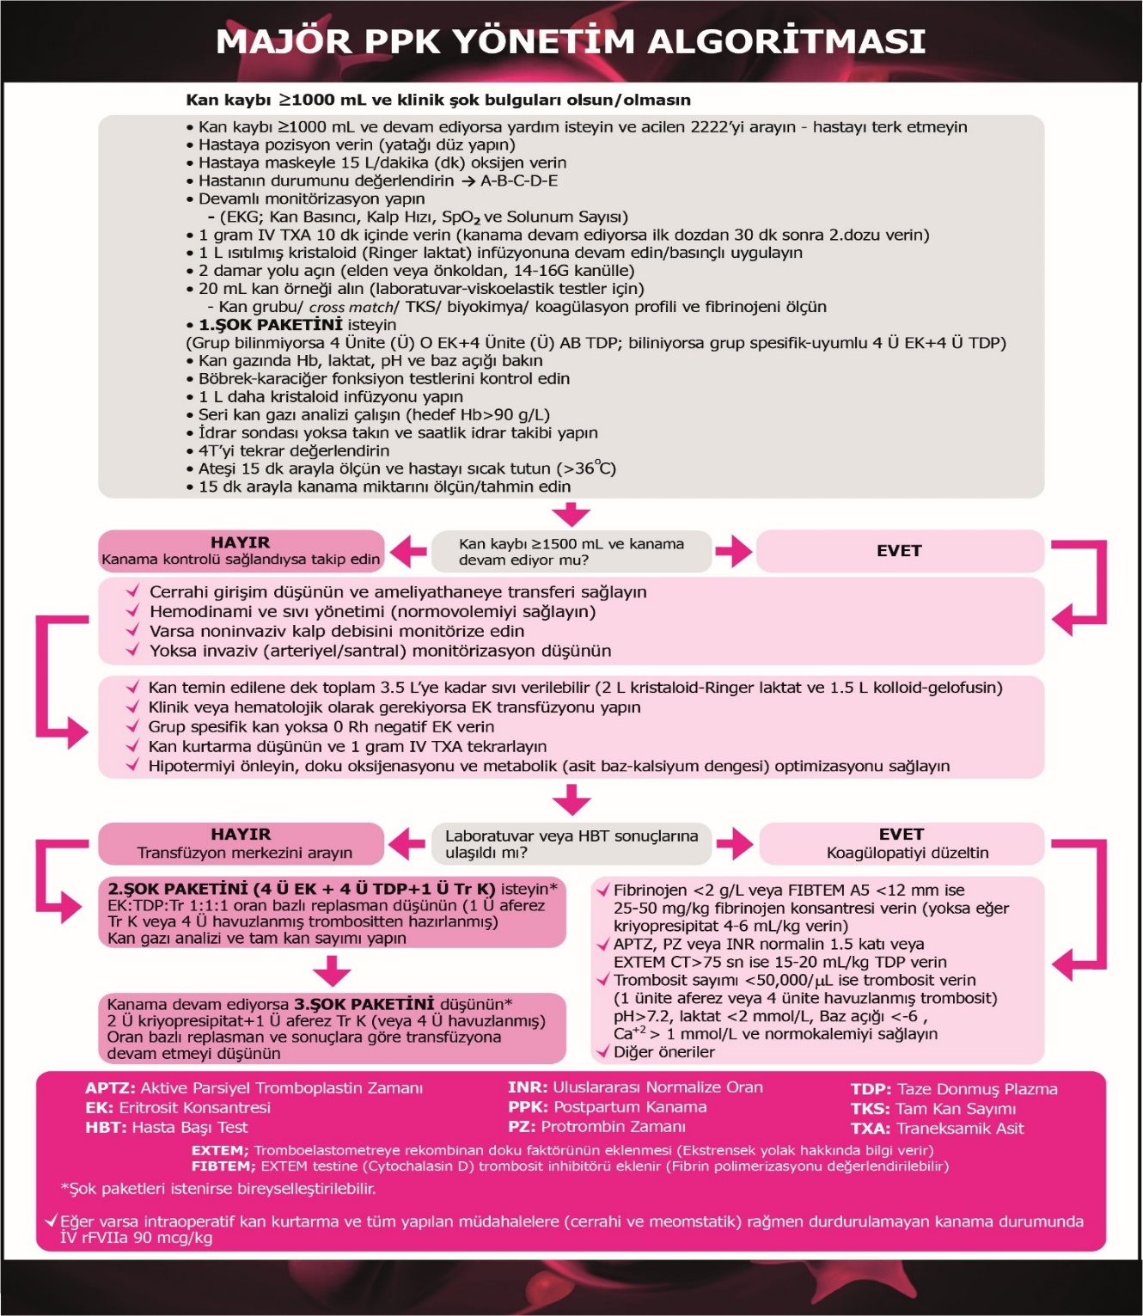
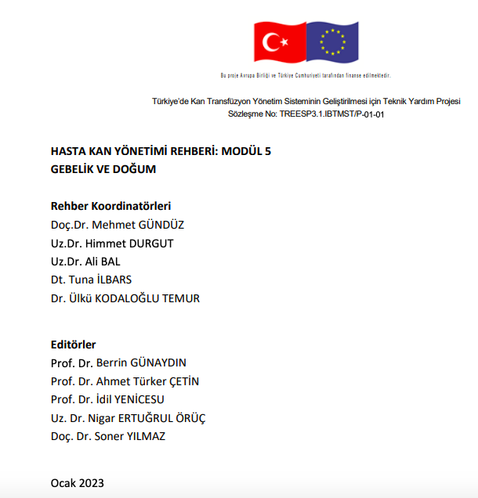
https://shgmkanhizmetleridb.saglik.gov.tr/Eklenti/44850/0/5-hasta-kan-yonetimi-rehberi-modul-5---gebelik-ve-dogumpdf.pdf EXPERT OPINION (EO) POINTS Adapting or modifying a massive transfusion protocol (MTP)
EO14 | In the maternity population, activate MTPs early
EO15 | The MTP should be modified for the maternity patient, because fibrinogen levels less than 2 g/L are indicative of critical physiological derangement and are associated with severe haemorrhage
Maternity & Obstetrics
PBM Module 5
Kan kaybı ≥ 1000 mL veya hipovolemi bulguları
(24 saatte doğum şeklinden bağımsız)

Slide 15
MTP
Blood loss ≥ 1500 mL
NO Lab. tests or VHA!!!
Lab. tests or VHA results arrived
Consider surgery - transfer to OR
Replace volume until blood arrives
Repeat 1 g IV of TXA
Prevent hypothermia
Optimise
oxygenation
acid-base status
calcium homeostasis
Administer 25-50 mg/kg IV fibrinogen concentrate or 4-6 ml/kg Crio (1 unit/10 kg)
(if fibrinogen <2 g/L or FIBTEM A5<12 mm)
Order 2nd Shock pack
4 U RBC+4 U FFP+1 pack apheresis PLT
Ratio driven therapy 1:1
Administer IV 15-20 ml/kg FFP
(if aPTT/INR 1.5 fold of normal or EXTEM CT > 75 sec)
Order 3rd Shock pack
2 U Crio + 1 pack PLT (apheresis)
Transfuse 1 pack of PLT apheresis
(if platelet count <50,000/µL)
Notes:
This is our modified MTP
Blood loss ≥1500 ml
Vital signs unstable
Ongoing bleeding
Progress to DIC?
Order 2nd shock pack (RBC, FFP, PLT=
In case of 2 L of blood loss Platelet Count is significantly reduced

Slide 16

Randomised Controlled Trial
Early and systematic administration of fibrinogen concentrate in postpartum haemorrhage following vaginal delivery: the FIDEL randomised controlled trial
AS Ducloy-Bouthors,FJ Mercier,JM Grouin,F Bayoumeu,J Corouge,A Le Gouez,T Rackelboom,F Broisin,F Vial,A Luzi,O Capronnier,C Huissoud,A Mignon,the FIDEL working group
First published: 13 March 2021
30 hospital, n=437
n=224 fibrinogen vs n=213 placebo
PPH after vaginal delivery
(switch from oxytocine to PG)
4 g/dL Hb decrease + 2 U RBC within 48 h
IV 3 g fibrinogen or placebo (30 min after PG )
Early and systematic IV 3 g fibrinogen
Blood loss
Transfusion need
Postpartum anemia did not decraese
Further hypofibrinogenemia prevented
without increase in thromboembolism
Notes:
Postpartum haemorrhage remains the main cause of maternal death worldwide [30]. An early correction of the PPH associated coagulopathy process (i.e. hypofibrinogenaemia) is expected to contribute to better management. CONCLUSION: Fibrinogen supplementation appears to be one of the most promising targets for this haemostatic intervention. However, the current level of scientific evidence that supports the indications, doses and timing for this supplementation is insufficient [31]. The FIDEL trial objectives are to demonstrate the efficacy and safety of the early administration of a 3 g fibrinogen concentrate given in patients experiencing PPH and resistant to oxytocin, using a randomised, double-blind multicentre design.

Slide 17
TACO

Slide 18
31 years (1989-2020)
93 RCTs
n=62 TEG vs n=31 ROTEM
Total n=32,8171
SSC: Scientific & Standardization Committee
ISTH: Int. Society of Thrombosis & Hemostasis
Systematic review demonstrated potential utility of TEG/ROTEM in obstetrics with several limitations (study design and/or results confounded by biases)
Routine use of ROTEM may have a best role in guiding transfusion therapy in severe PPH
Multicenter further clinical trials are needed to validate TEG/ROTEM-guided approaches to determine clinical outcomes, morbidity/mortality in obstetrics.
Recommendations VHA-guided intervention protocol is suggested in severe PPH (2C)
VHA can identify obstetric coagulopathy including hypofibrinogenaemia and reduced platelet level (B)
VHA-guided haemostatic treatment reduces the need for blood products (B) ESAIC Guidelines, 2023
Notes:
SCIENTIFIC AND STANDARDIZATION COMMITTEE, Int Society of Thrombosis and Hemostasıs.
Final recommendations to fill the gaps
Lack of quantitative analyses plus heterogenity of the studies to perform a meta-analysis
93 studies demonstrated potential utility of TEG/ROTEM in obstetrics with several limitations (study design and/or results confounded by biases)
Based on overview of the literature, the routine use of ROTEM may best serve a role in clinically guiding transfusion therapy in obstetrics and identifying patients at risk for severe hemorrhage
Ideally large controlled multicenter further clinical trials are needed to validate TEG/ROTEM-guided approaches and applicability in obstetrics and determine their effects on clinical outcomes to reduce morbidity/mortality in obstetrics.

Slide 19
PRACTICE POINTS (PP) Tranexamic acid (TXA)
PP32 | In maternity patients with significant blood loss, the early use (within 3 hrs of the onset of haemorrhage) of TXA is considered. Its use is labelled for peripartum bleeding, postoperative bleeding (uterine-vaginal surgeries) and DIC with hyperfibrinolysis.
PP33 | TXA should be administered in the context of overall patient management; the protocol should include strict attention to the control of bleeding, physiological and metabolic parameters, coagulation status and temperature maintenance.
PRACTICE POINTS (PP) interventional radiology (IR)
PP27 | Preventive IR may be appropriate in selected maternity patients; however, the risk of complications from this procedure should be balanced against the potential benefits.
PP28 | Although the role of therapeutic IR in the treatment of major obstetric haemorrhage is unknown, it may be considered in the overall approach to management.
PRACTICE POINTS (PP) recombinant activated factor VII (rFVIIa)
PP29 | The administration of rFVIIa may be considered in maternity patients with life-threatening haemorrhage, but only after conventional measures (including surgical haemostasis and appropriate blood component therapy) have failed *rFVIIa is not licensed for this use. Its use should only be considered in exceptional circumstances
PP30 | Ideally, rFVIIa should only be administered to maternity patients as part of a locally adapted MTP. The MTP should include strict attention to the control of bleeding, physiological and metabolic parameters, coagulation status and temperature maintenance
PP31 | When rFVIIa is administered to maternity patients with life-threatening haemorrhage, an initial dose of 90 μg/kg is suggested
Notes:
The systematic review identified two Level I reviews66,67 containing only Level III and IV evidence, but did not include any pooled analysis; hence, the primary Level III retrospective cohort studies of fair quality were assessed.68-70 An additional poor-quality prospective Level III study was identified.71

Slide 20
Indications for cell salvage
high risk of bleeding in whom transfusion is not an option
during caesarean with high risk of haemorrhage it may decrease allogeneic transfusion need
well tolerated in obstetrics if precautions are taken
in Rh D negative parturients receiving salvaged blood where the cord blood group is Rh D positive, Rh D immunoglobulin is required on the result of fetomaternal haemorrhage test
consider using it in severe bleeding if the potential benefit is most apparent
requires procedural guideline (patient selection, use of equipment and reinfusion, appropriately trained all staff)
Eur J Anaesthesiol 2023 Management of severe peri-operative bleeding: Guidelines from the ESAIC Second update 2022
https://shgmkanhizmetleridb.saglik.gov.tr/Eklenti/44850/0/5-hasta-kan-yonetimi-rehberi-modul-5---gebelik-ve-dogumpdf.pdf

Slide 21
Is there a role for PCC in PPH management?
4F-PCC contains FII, VII, IX, X, protein C, S & AT
Indicated only for VKA dependent bleeding
Off label administration in PPH management?
  use of PCC might reduce need for FFP in PPH
Eur J Anaesthesiol 2023; 40:226–304

Slide 22
Triggers and Targets
Shock index and pulse pressure
Lactate and base deficit
Plasma fibrinogen < 2 g/L
RBC transfusion in PPH
  increases risk of VTE & immunomodulation
  decreases breastfeeding
  develops cardiovascular disease later in life
Restrictive Hb threshold of 7 g/dL seems safe and justified
Eur J Anaesthesiol 2023 Management of severe peri-operative bleeding

Slide 23
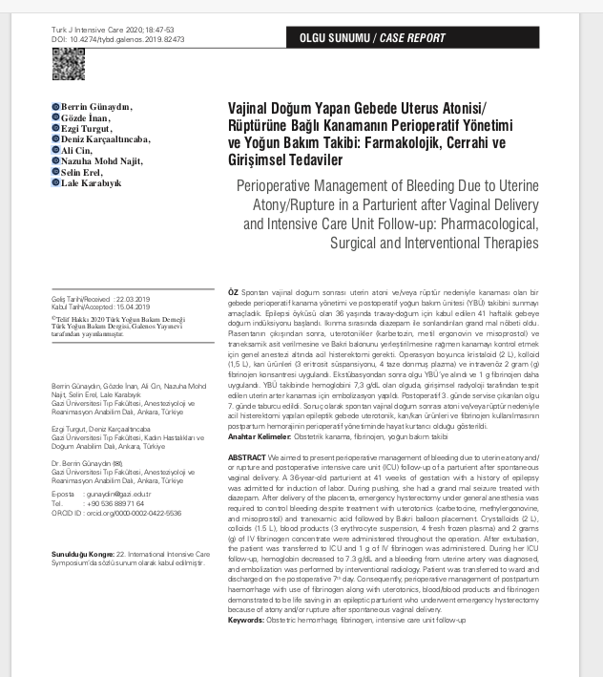
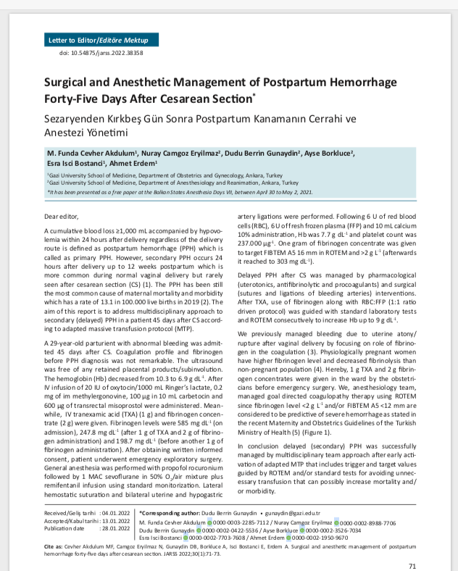
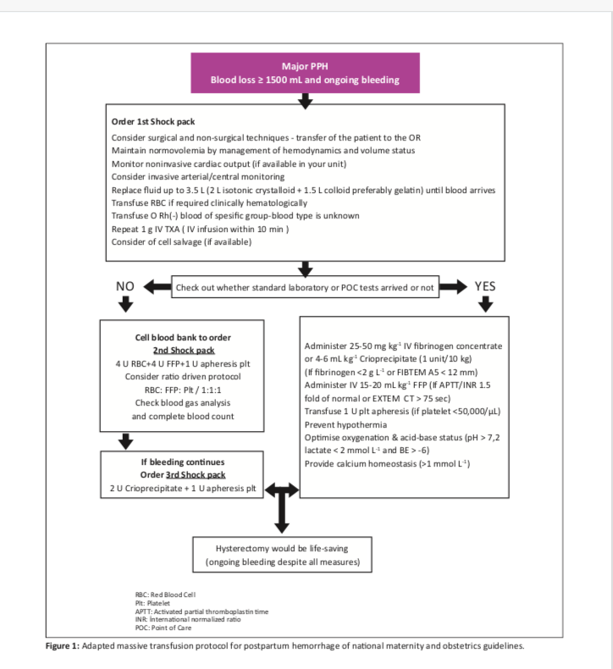
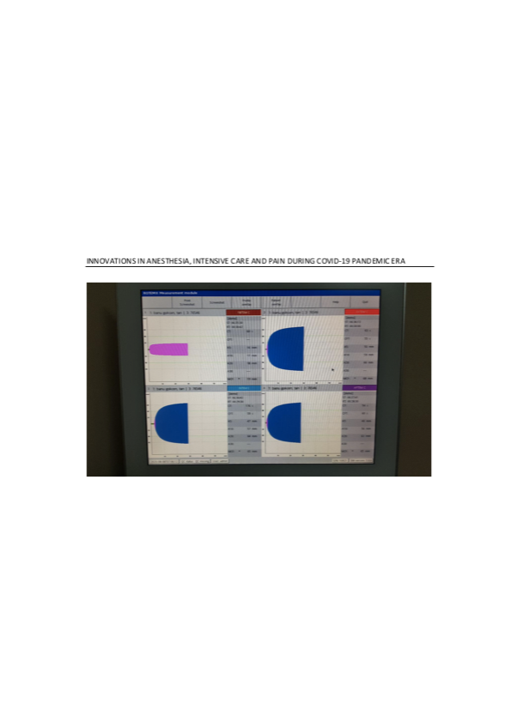
A 36-year-old term multiparous parturient
admitted for induction of labor had uterine atony/rupture.
A 29-year-old patient admitted with vaginal bleeding for surgical-anesthetic management 45 days after CS
Notes:
Primary and Secondary PPH management examples.

Slide 24
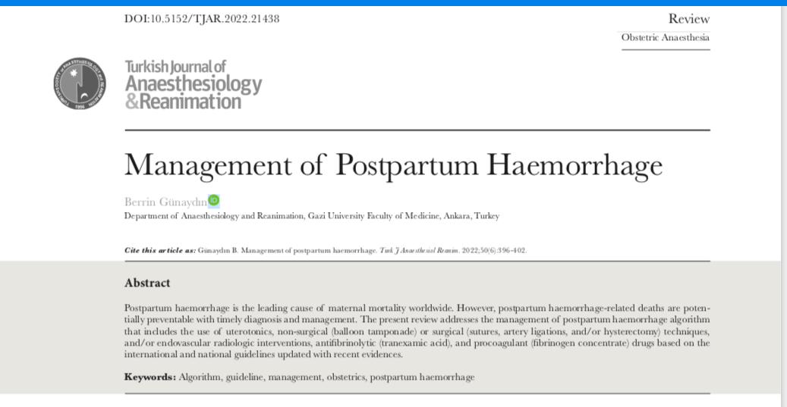
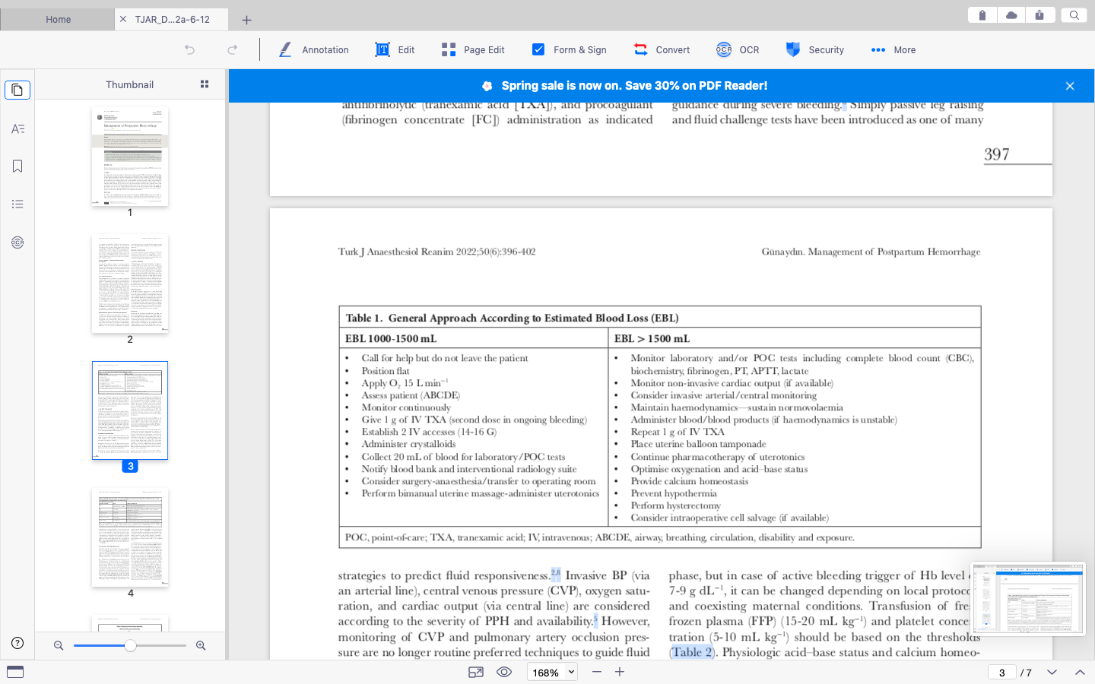
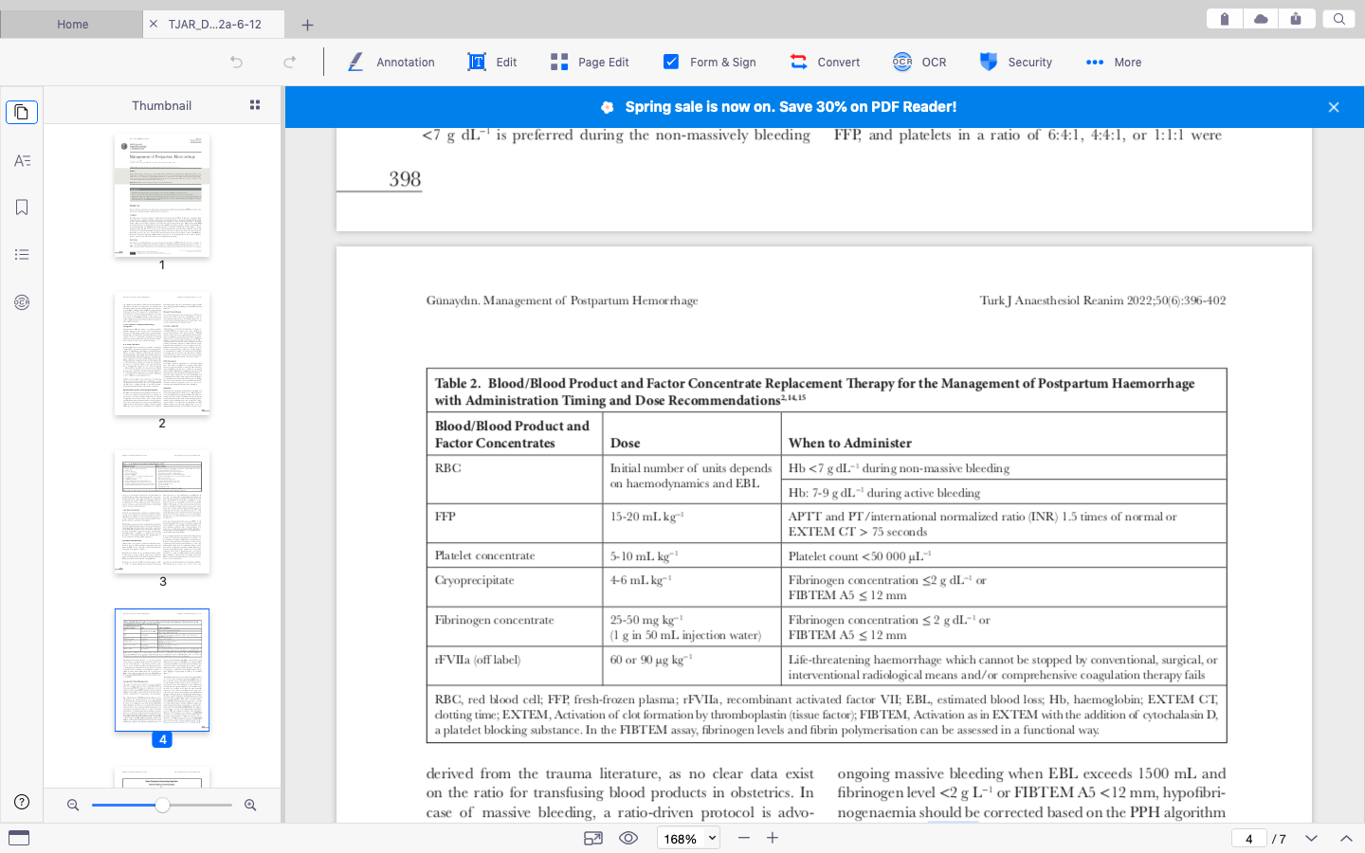

Slide 25
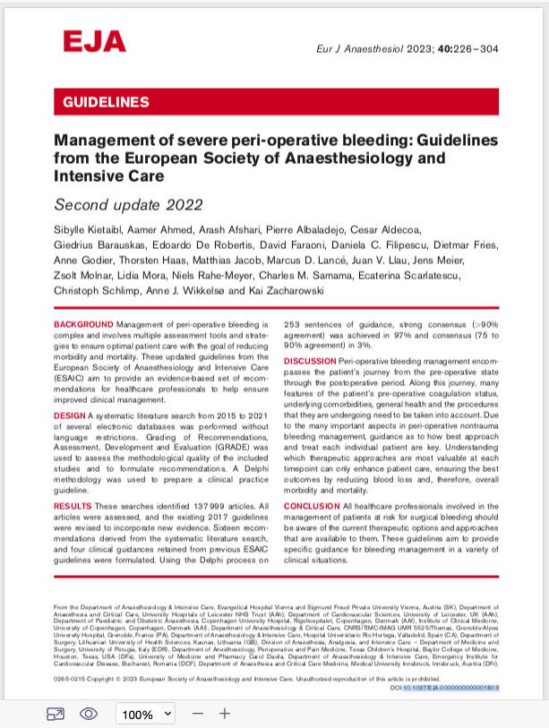
Guidelines
Maternity & Obstetrics
PBM Module 5
https://shgmkanhizmetleridb.saglik.gov.tr/Eklenti/44850/0/5-hasta-kan-yonetimi-rehberi-modul-5---gebelik-ve-dogumpdf.pdf

Slide 26
Last
In the multidisciplinary management of PPH, use of ALGORITHMS that include trigger and target values under the guidance of POC-VHA and/or standard coagulation tests might avoid unnecessary blood/blood product transfusion that can increase mortality and/or morbidity.
Berrin Günaydın
gunaydin@gazi.edu.tr
www.berringunaydin.com
Thank you!

