Slide 1
PATIENT CARE CENTERED INTERDISCIPLINARY TEAM APPROACHES: Patient Blood Management (PBM)
Berrin Günaydın, MD, PhD
Gazi University School of Medicine
Department of Anesthesiology in Ankara, Turkey

Slide 2
Declaration of conflict of interest
The presenter declares that she does not present conflicts of interest
Editor of PBM Guideline on Maternity and Obstetrics (Module 5) associated with technical assistance project on improving the blood transfusion management system in Turkey

Slide 3
Patient-Centered Care
The health care system’s mission, vision, values, leadership, and quality-improvement drivers are aligned to patient-centered goals:
collaboratively coordinated, and accessible
at the right time & right place that
focuses on physical comfort as well as emotional well-being of
patient and family preferences, values, respecting cultural traditions, and socioeconomic conditions
patients and their families are an expected part of the care team and play a role in decisions
information is shared fully and in a timely manner so that patients and their family members can make informed decisions

Slide 4
Targets
To improve both individual and population health outcomes
Not only patients do benefit, but also providers-health care systems benefit through:
improved satisfaction scores among patients and their families
enhanced reputation of providers among health care consumers
better morale and productivity among clinicians and staff
improved resource allocation
reduced expenses and
increased financial margins throughout the continuum of care

Slide 5
For teaching Patient-Centered Care
Continuum of care
Multidisciplinary health care team
Effective communication skills, advocacy skills and social understanding with patients of all ages and their families within diverse and multicultural contexts
Appropriate professional, ethical and gender competent behavior with patients and members of the health care team
Familiarity with the medico-legal responsibilities
An awareness of health care quality improvement activities are required
Notes:
FOR………….required

Slide 6
Multi-Disciplinary Team Approach
As disease management becomes increasingly complex, bringing together a group of experts, all of whom can independently contribute to a diagnosis and treatment strategy is important
Multidisciplinary discussion is mandatory to facilitate the delivery of timely management and treatment
Notes:
MDTA means…

Slide 7
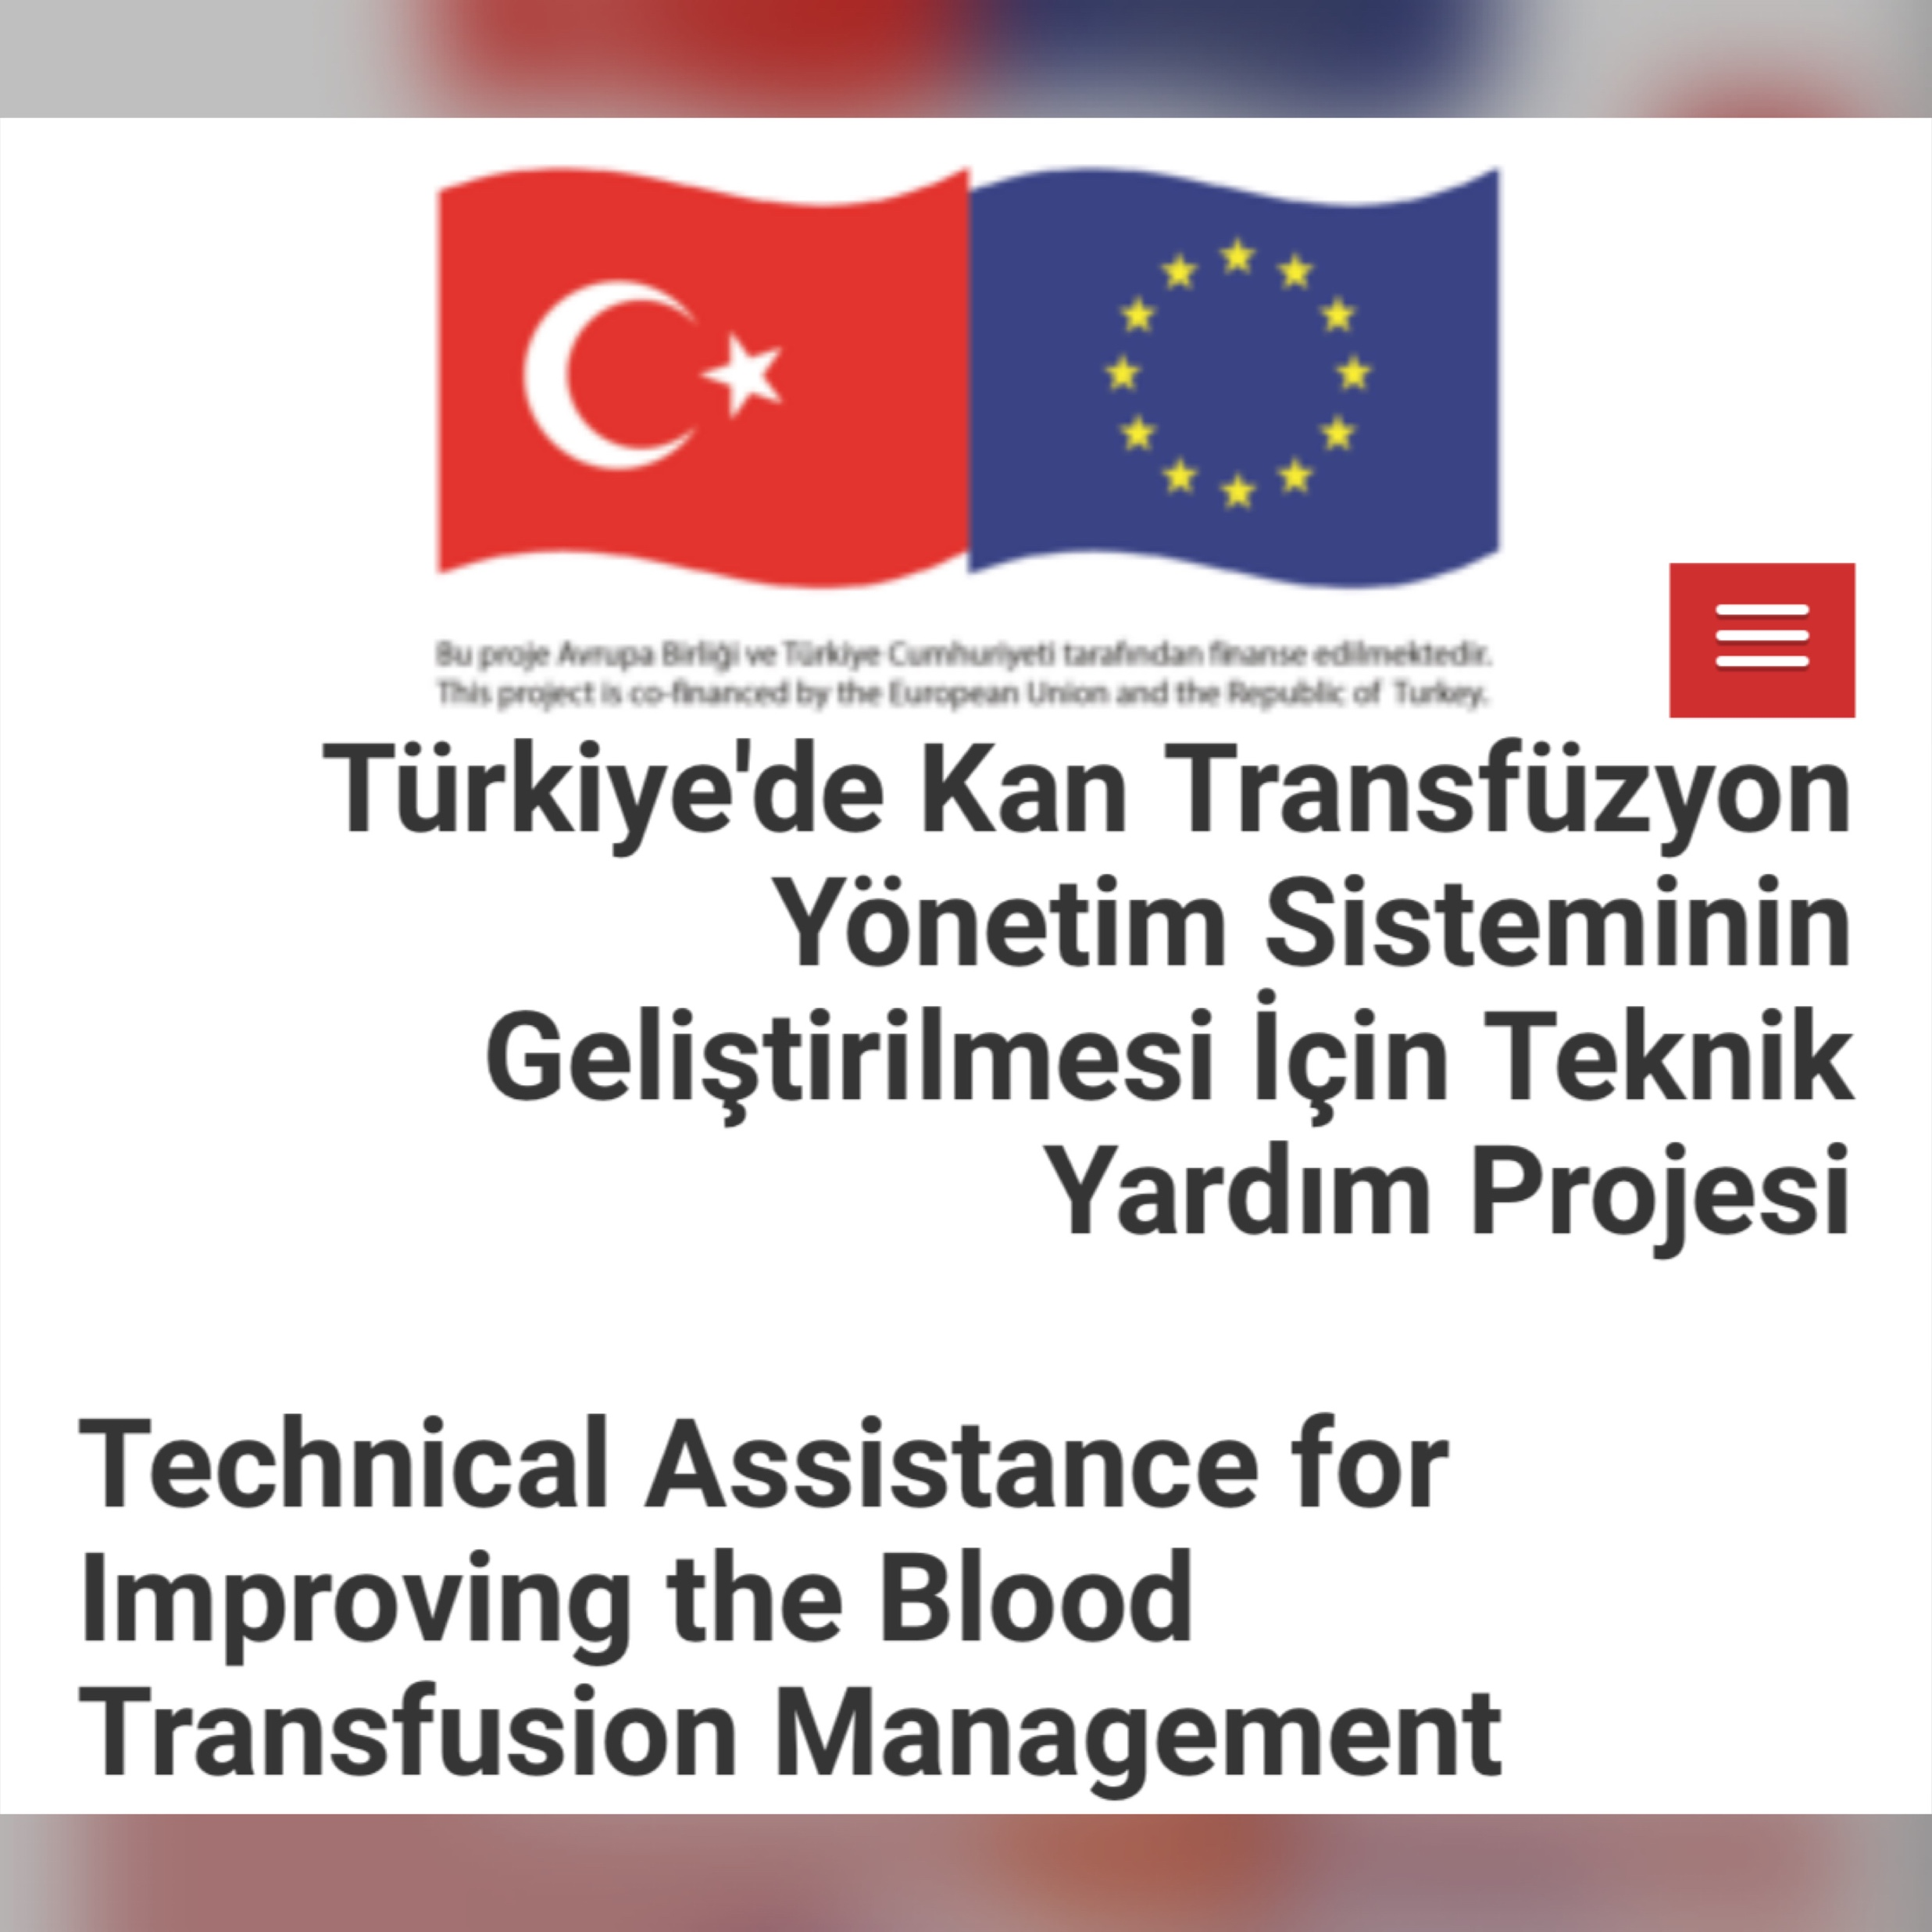
22 National Societies contributed
6 Guidelines launched recently (January 2023)
Between March 20, 2019- March 20, 2022

Slide 8
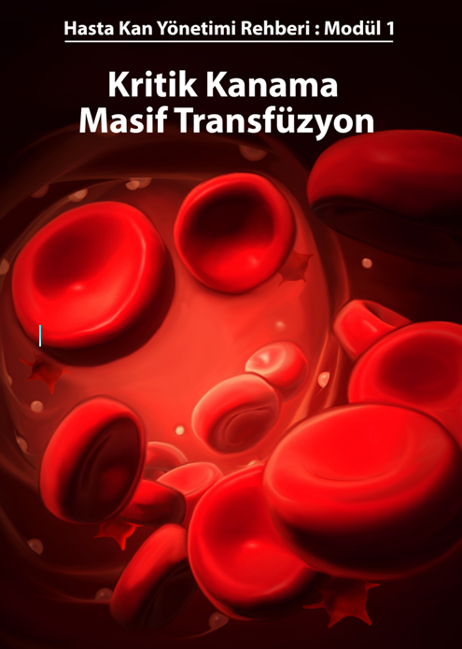
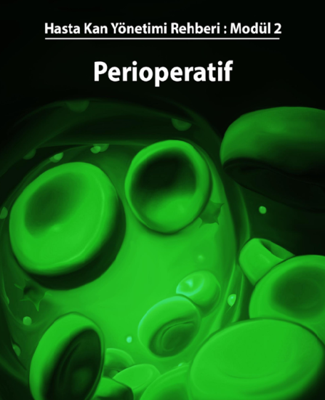
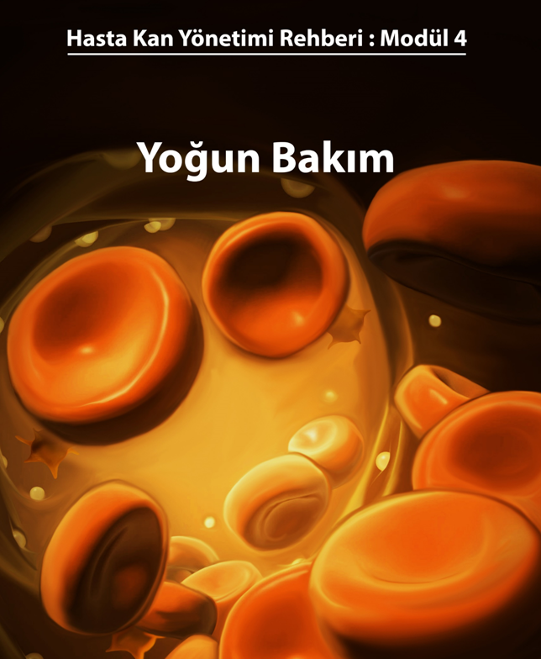
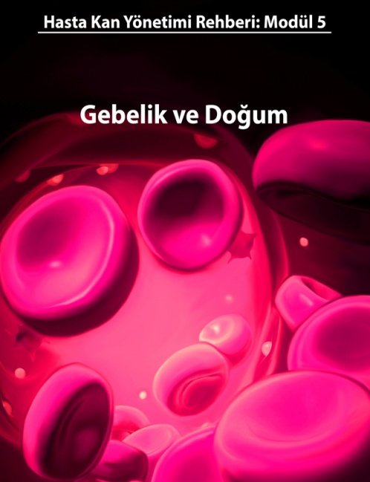
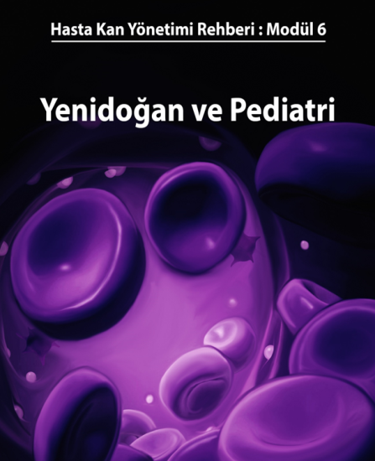
Critical Bleeding-Massive transfusion
Module 1
Perioperative
Module 2
Internal Medicine
Module 3
6 Guidelines Translated/Updated to prepare 6 National Guidelines
ICU
Module 4
Maternity and Obstetrics
Module 5
Newborn and Pediatrics
Module 6

Slide 9
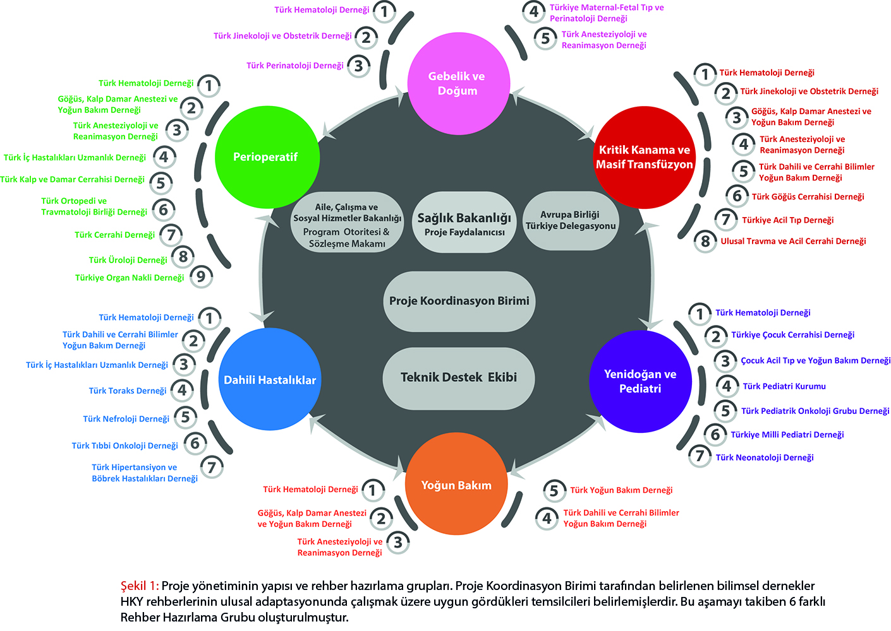
2020
Technical Assistance Project on improving the blood transfusion management system in Turkey
Notes:
Projeden beklenen çIktIlar
HKY strateji ve aksiyon planı ve KANITA DAYALI 6 FARKLI ULUSAL HKY REHBERLERİN HAZIRLANMASI
Anketlerle eğitim ihtiyaç analizleri/Transfüzyon zincirinde görev alan 2520 uzman hekime doğrudan; en az 7500 hekime web aracılığı ile eğitim

Slide 10
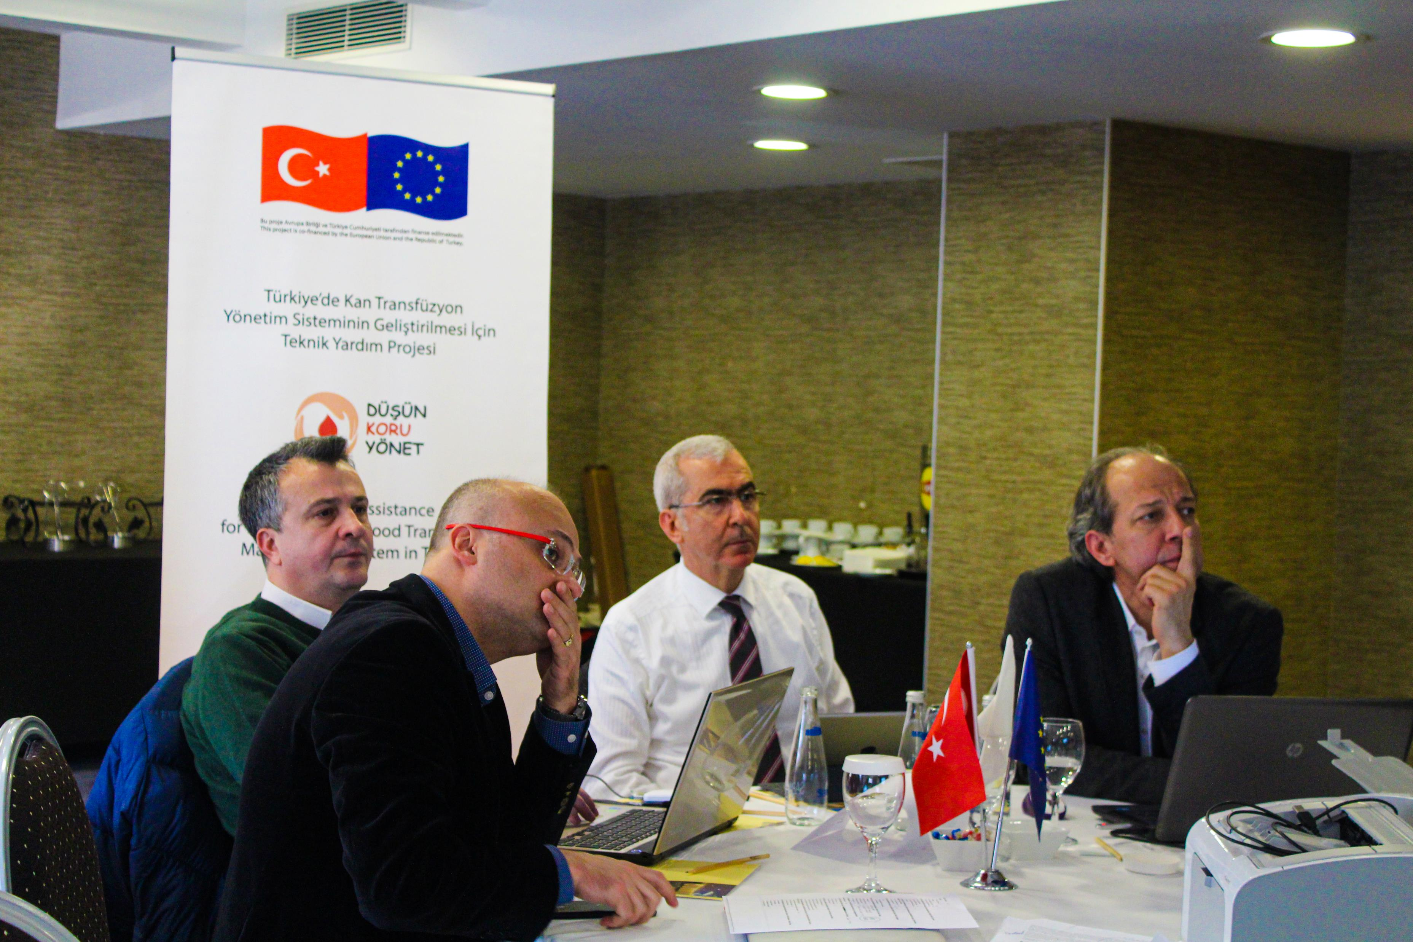
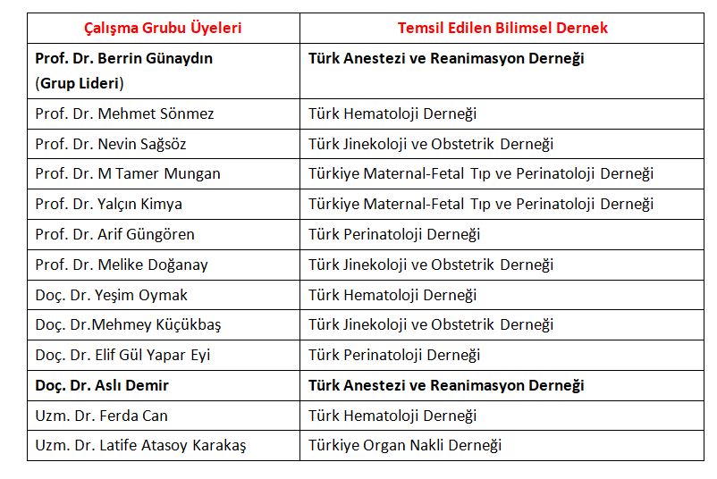
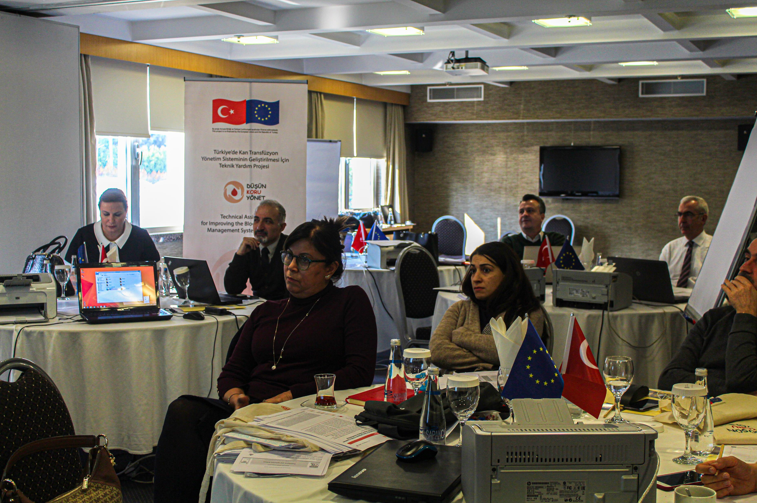
Maternity&Obstetrics
PBM GUİDELİNE
Prof.Berrin Gunaydın,
Turkish Society of Anesthesiology & Reanimation
Group leader
Module 5: PBM Guideline preparation team

Slide 11
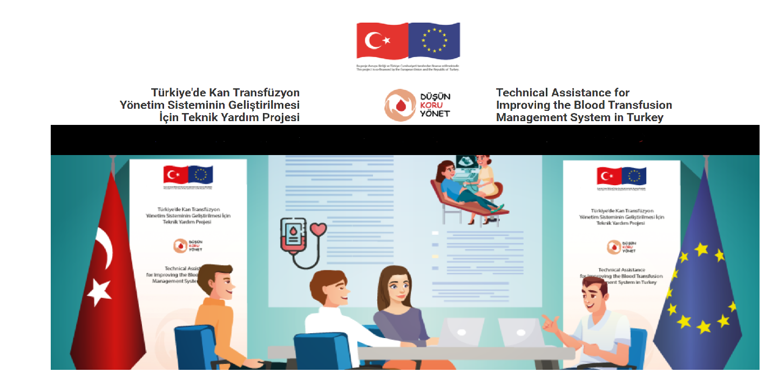
Project Share holders
1123 Hospitals Countrywide Analyzed
283 Hospitals Using Majority of Blood Products in the Country Identified (80%)
3130 Physicians Trained
Training of the Trainers Courses (175 Physicians)
Post-Training Audit- Societies
Post-training Audit –National Reimbursement Authority
Negotiations with National Body of Academic Institutions for Implementation of Courses into Medical School Curriculum
Implementation of Specific Software
Distance-learning

Slide 12
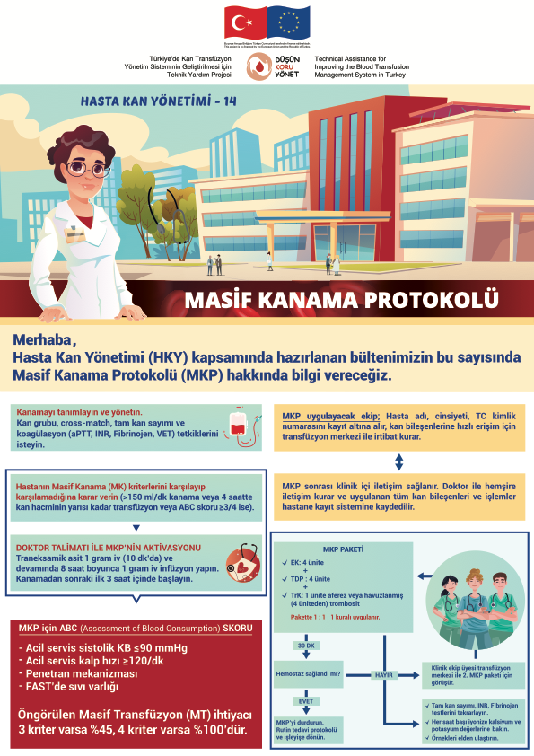
For the implementation of PBM
Education program Education initiatives; SOP, clinical protocols, visual aids, checklists, algorithms Massive hemorrhage protocols; coagulation and transfusion algorithms
Maternity & Obstetrics
Critical Bleeding-
Massive transfusion

Slide 13
Online education (2 day long) to physicians
PBM Basics, national guidelines
& interactive case scenarios for each module
(pre-post tests & feedbacks)
https://hastakanyonetimi.saglik.gov.tr/

Slide 14
Recommendations for the implementation of PBM
Education program Online PBM e-learning course- Education at medical schools and hospital level
Day 1 |  |  | PBM Basics
09:00-09:20 | Pre-Test (Prof Dr Berrin Günaydın)
09:30-10:20 | PBM- Introduction and objectives I) PBM Pillars (Prof Dr Berrin Günaydın)
10:30-11:20 | I) Optimization of Hemoglobin II) Kanama olasılığının azaltılması, III) Hastanın anemiye toleransının değerlendirilmesi (Eğitici: Prof Dr Salih Aksu)
11:30-12:00 | Introduction of National Guidelines (Prof Dr Berrin Günaydın)
LUNCH
13:00-14:45 Each case 30 min -Q/A 5 min | Hall 1 | Olgu: Eritrosit kitlesinin optimizasyonu (Eğitici: Doç Dr Neslihan Andıç) | Olgu: Eritrosit kitlesinin optimizasyonu (Eğitici: Doç Dr Neslihan Andıç) | Olgu: Kanama olasılığının azaltılması (Eğitici: Prof Dr Serdar Günaydın) | Olgu: Kanama olasılığının azaltılması (Eğitici: Prof Dr Serdar Günaydın) | Olgu: Anemi toleransı (Eğitici: Prof Dr Salih Aksu)
 | Hall 2 | Olgu: Kanama olasılığının azaltılması (Eğitici: Prof Dr Serdar Günaydın) | Olgu: Kanama olasılığının azaltılması (Eğitici: Prof Dr Serdar Günaydın) | Olgu: Anemi toleransı (Eğitici: Prof Dr Salih Aksu) | Olgu: Anemi toleransı (Eğitici: Prof Dr Salih Aksu) | Olgu: Eritrosit kitlesinin optimizasyonu (Eğitici: Doç Dr Neslihan Andıç)
 | Hall 3 | Olgu: Anemi toleransı (Eğitici: Prof Dr Salih Aksu) | Olgu: Anemi toleransı (Eğitici: Prof Dr Salih Aksu) | Olgu: Eritrosit kitlesinin optimizasyonu (Eğitici: Doç Dr Neslihan Andıç) | Olgu: Eritrosit kitlesinin optimizasyonu (Eğitici: Doç Dr Neslihan Andıç) | Olgu: Kanama olasılığının azaltılması (Eğitici: Prof Dr Serdar Günaydın)
15:00-17:00 Each topic 35 min | Hall 1 | HKY sisteminin hastaya ve sağlık çalışanlarına yararları (Eğitici: Doç Dr Neslihan Andıç) | HKY sisteminin hastaya ve sağlık çalışanlarına yararları (Eğitici: Doç Dr Neslihan Andıç) | Türkiye'de HKY nasıl uygulanabilir (Eğitici: Prof Dr Serdar Günaydın) | Türkiye'de HKY nasıl uygulanabilir (Eğitici: Prof Dr Serdar Günaydın) | HKY sisteminin uygulanmasındaki engeller (Eğitici: Doç Dr Yeşim Oymak)
 | Hall 2 | Türkiye'de HKY nasıl uygulanabilir (Eğitici: Prof Dr Serdar Günaydın) | Türkiye'de HKY nasıl uygulanabilir (Eğitici: Prof Dr Serdar Günaydın) | HKY sisteminin uygulanmasındaki engeller (Eğitici: Doç Dr Yeşim Oymak) | HKY sisteminin uygulanmasındaki engeller (Eğitici: Doç Dr Yeşim Oymak) | HKY sisteminin hastaya ve sağlık çalışanlarına yararları (Eğitici: Doç Dr Neslihan Andıç)
 | Hall 3 | HKY sisteminin uygulanmasındaki engeller (Eğitici: Doç Dr Yeşim Oymak) | HKY sisteminin uygulanmasındaki engeller (Eğitici: Doç Dr Yeşim Oymak) | HKY sisteminin hastaya ve sağlık çalışanlarına yararları (Eğitici: Doç Dr Neslihan Andıç) | HKY sisteminin hastaya ve sağlık çalışanlarına yararları (Eğitici: Doç Dr Neslihan Andıç) | Türkiye'de HKY nasıl uygulanabilir (Eğitici: Prof Dr Serdar Günaydın)

Slide 15
09:00-09:20 | Pre-Test (Eğitici: Prof Dr Serdar Günaydın)
09:30-10:20 | HKY- Giriş ve Gerekçe, I) Eritrosit kitlesinin optimizasyonu (Eğitici: Prof Dr Serdar Günaydın)
10:30-11:20 | II) Minimizing bleeding III) Evaluation of tolerance to anemia (Prof Dr Berrin Günaydın)
11:30-12:00 | Introduction of national guidelines (Prof Dr Berrin Günaydın)
LUNCH
13:00-14:4530 dakika Each case 30 min Q/A 5 min | HALL 1 | Case: Optimization of Hb (Prof Dr Berrin Günaydın) | Case: Optimization of Hb (Prof Dr Berrin Günaydın) | Olgu: Kanama olasılığının azaltılması (Eğitici: Prof Dr Serdar Günaydın) | Olgu: Kanama olasılığının azaltılması (Eğitici: Prof Dr Serdar Günaydın) | Olgu: Anemi toleransı (Eğitici: Doç Dr Yeşim Oymak)
 | HALL 2 | Olgu: Kanama olasılığının azaltılması (Eğitici: Prof Dr Serdar Günaydın) | Olgu: Kanama olasılığının azaltılması (Eğitici: Prof Dr Serdar Günaydın) | Olgu: Anemi toleransı (Eğitici: Doç Dr Yeşim Oymak) | Olgu: Anemi toleransı (Eğitici: Doç Dr Yeşim Oymak) | Case: Optimization of Hb (Prof Dr Berrin Günaydın)
 | HALL 3 | Olgu: Anemi toleransı (Eğitici: Doç Dr Yeşim Oymak) | Olgu: Anemi toleransı (Eğitici: Doç Dr Yeşim Oymak) | Case: Optimization of Hb (Prof Dr Berrin Günaydın) | Case: Optimization of Hb (Prof Dr Berrin Günaydın) | Olgu: Kanama olasılığının azaltılması (Eğitici: Prof Dr Serdar Günaydın)
EACH TOPIC 35 MİN | HALL 1 | HKY sisteminin hastaya ve sağlık çalışanlarına yararları (Eğitici: Doç Dr Yeşim Oymak) | HKY sisteminin hastaya ve sağlık çalışanlarına yararları (Eğitici: Doç Dr Yeşim Oymak) | Türkiye'de HKY nasıl uygulanabilir (Eğitici: Prof Dr Serdar Günaydın) | Türkiye'de HKY nasıl uygulanabilir (Eğitici: Prof Dr Serdar Günaydın) | Barriers against PBM implementation Prof Dr Berrin Günaydın)
 | HALL 2 | Türkiye'de HKY nasıl uygulanabilir (Eğitici: Prof Dr Serdar Günaydın) | Türkiye'de HKY nasıl uygulanabilir (Eğitici: Prof Dr Serdar Günaydın) | Barriers against PBM implementation Prof Dr Berrin Günaydın) | Barriers against PBM implementation Prof Dr Berrin Günaydın) | HKY sisteminin hastaya ve sağlık çalışanlarına yararları (Eğitici: Doç Dr Yeşim Oymak)
 | HALL 3 | Barriers against PBM implementation Prof Dr Berrin Günaydın) | Barriers against PBM implementation Prof Dr Berrin Günaydın) | HKY sisteminin hastaya ve sağlık çalışanlarına yararları (Eğitici: Doç Dr Yeşim Oymak) | HKY sisteminin hastaya ve sağlık çalışanlarına yararları (Eğitici: Doç Dr Yeşim Oymak) | Türkiye'de HKY nasıl uygulanabilir (Eğitici: Prof Dr Serdar Günaydın)

Slide 16
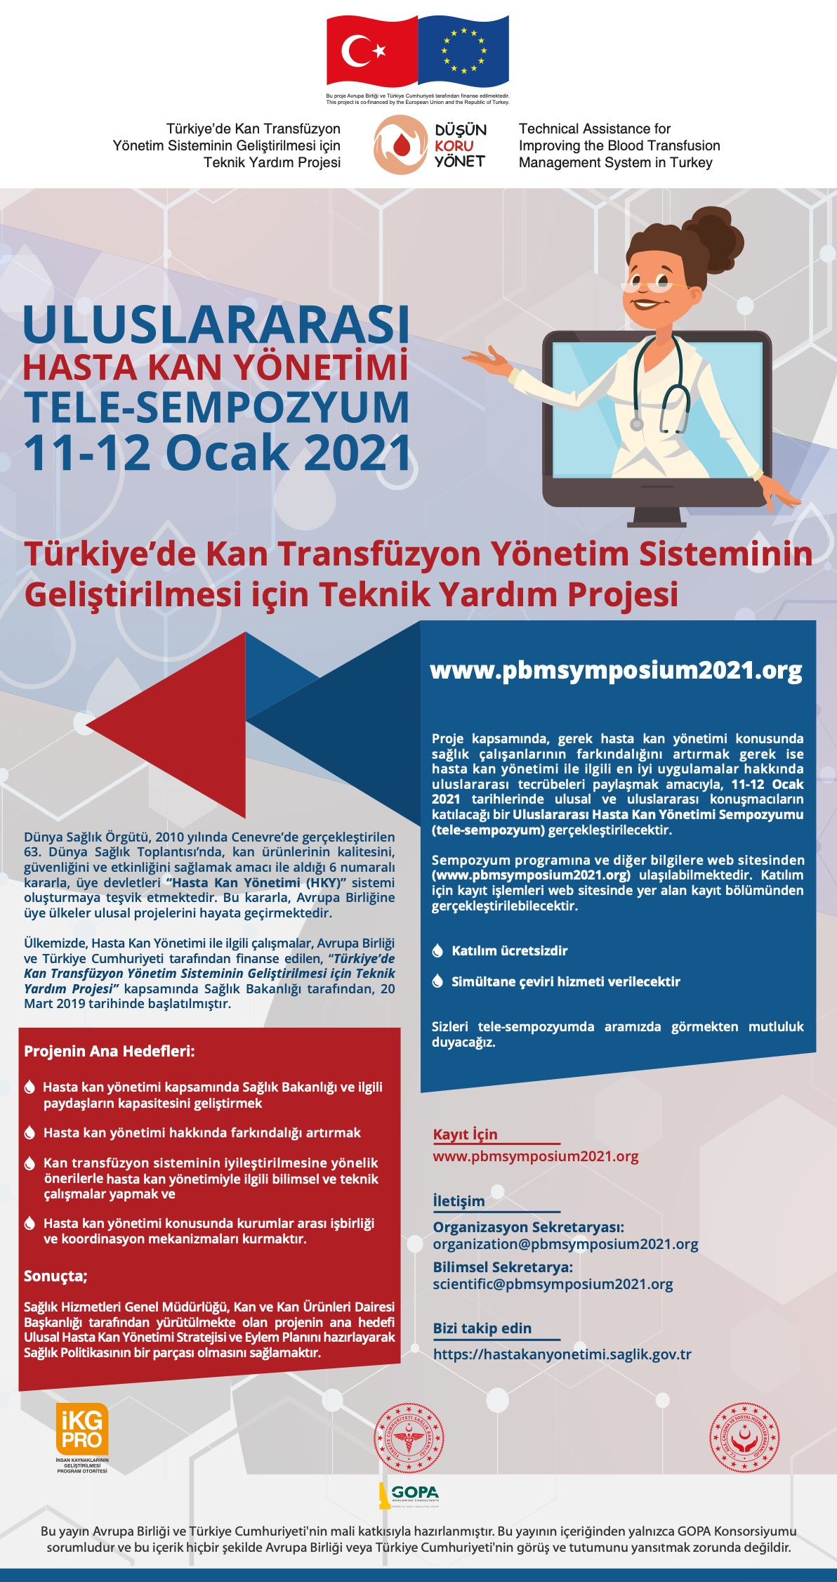
https://hastakanyonetimi.saglik.gov.tr/
Activities
Launching event
İnformation meetings
Press conferences
International symposium
Workshops
Training activities
Meetings with hospital administrators
International PBM Tele-Symposium, January 11-12, 2021

Slide 17
PcPBM
History
Definition
Practice
Notes:
There are couple of resasons why I would give this talk to YOU…1st; I have been the Task Force Coordinator of PBM Guideline : Maternity and Obstetrics and instructor of online PBM education in the country associated with Technical Assistance Project on improving the blood transfusion management system in Turkey. Because of this I have been one of the PBM implementors in Turkey and in Gazi University Hospital

Slide 18
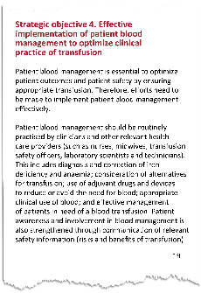
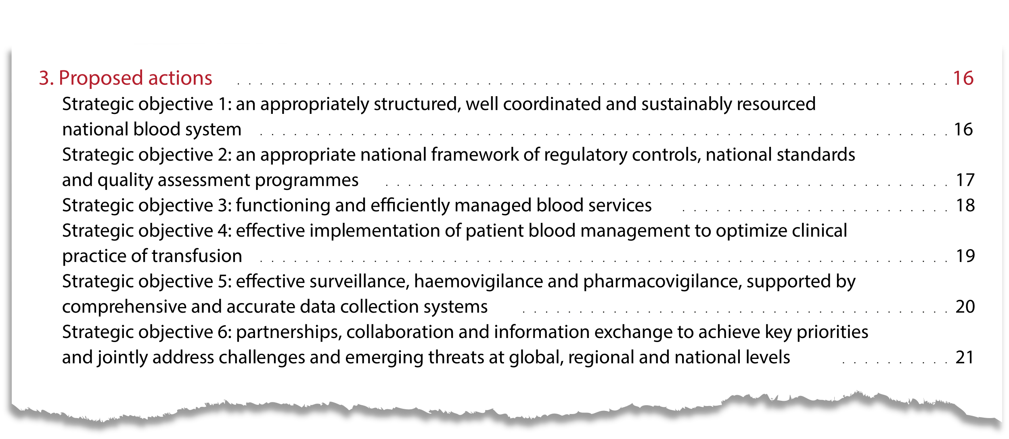
2005 PBM term was first used by James Isbister in J Updates Blood Conservation & Transfusion Alternatives
2010 World Health Assembly first approved PBM concept (Decision number WHA63.12)
2017 European Council first accepted PBM as a standard patient care
2020-2023 WHO indicated effective PBM implementation to optimize clinical practice of transfusion as a strategic objective
Notes:
HKY kavramı 2010 yılında Dünya Sağlık Asamblesi tarafından WHA63.12 kararı ile onaylanmıştır. 2017 yılında Avrupa Komisyonu tarafından standart bakım modeli olarak önerilmiştir. 2020-2023'te güvenli, etkili ve kalitesigüvence altına alınmış kan bileşenlerine evrensel erişimi artırmak için son “Dünya Sağlık Örgütü (DSÖ) Eylem Çerçevesi”nde, HKY'nin etkin uygulanması 6 hedefin 1'i olarak listelenmiştir. Bu güçlü önerilere ve bunu gösteren mevcut kanıtlara karşın HKY modeli sadece bir seçenek değil, bir zorunluluktur.

Slide 19
Definition of PBM
Optimize Hb
Minimize blood loss
Provide physiologic tolerance to anemia
the timely application of evidence-based medical and surgical concepts designed to maintain hemoglobin concentration, optimize hemostasis, and minimize blood loss in an effort to improve patient outcomes by a multimodal and interdisciplinary team approach

Slide 20
PcBM paradigm includes 4 guiding principles
Early detection of anemia
Adopt precise & meticiulous surgical technique
Listen to patient’s needs, concerns & desires
Assess coagulation status
Consider rational use of RBC
Employ goal directed therapy
Assess true cause of bleeding
Consider rational use of FFP
Determine causes & contributing factors
Employ interventions to support erythropoiesis timely
Enhance physiologic tolerance to anemia
Diagnose & stop blood loss promptly
Use intra-/postoperative autologous blood conservation modalities available
Employ intraoperative blood conservation
Inform patients about risks, benefits & alternative treatment choices
Decide together & tailor plan
Provide information about PBM interventions
I. Management
of anemia
II.Blood
conservation
Patient
III. Optimizing
coagulation
IV. Patient-centered
decision making
Patient-Centered Blood Management (PBM). Hohmuth et al. J Hospital Med 2014

Slide 21
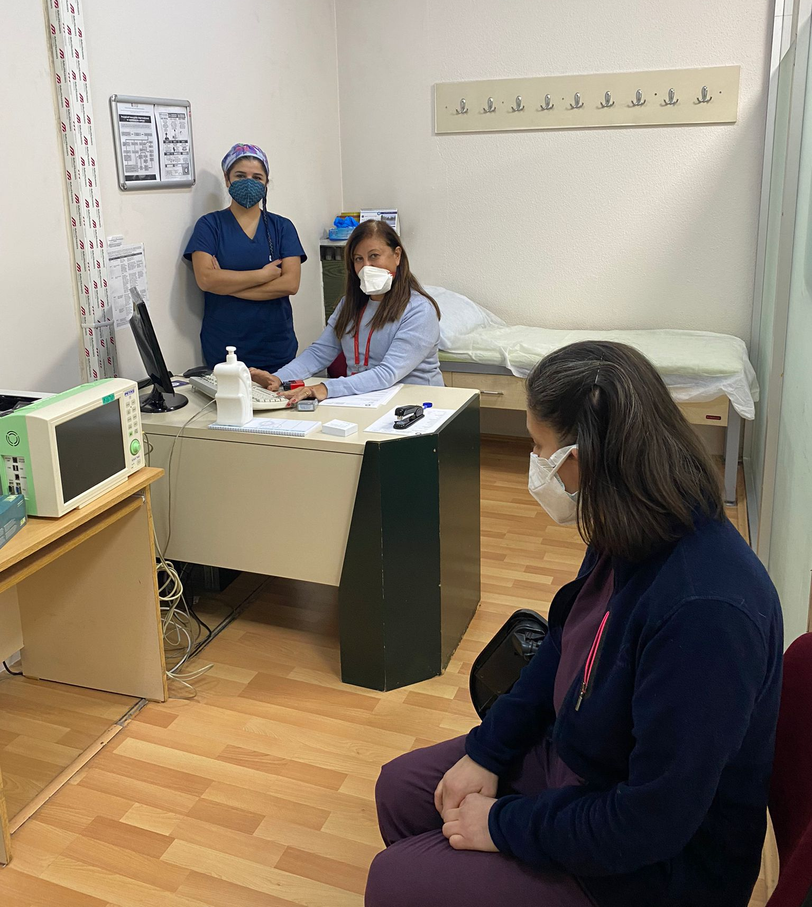
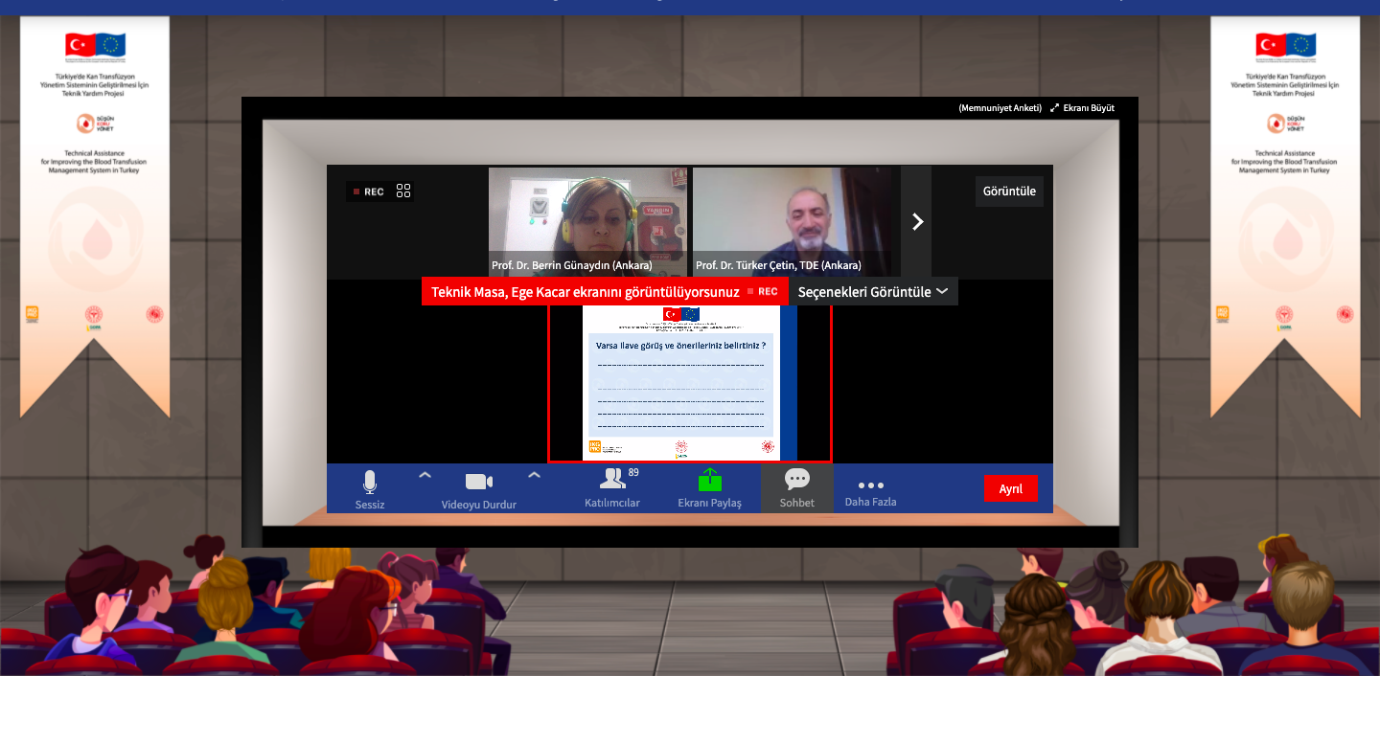
Adopting aPBM implementation
PBM
Module 2
Perioperative
2
1
Preoperative Evaluation –
Anemia Screening
National Guidelines
Online PBM education
1
2
3
3

Slide 22
Preoperative optimal levels for a surgical patient
Management of Anemia: Preoperative Evaluation
Anemia Screening
History- physical exam - laboratory tests
CBC – Hb, MCV, MCHC
Reticulocyte count
Ferritin concentration
Transferrin saturation or concentration
Serum iron & iron binding capacity
CRP
Sedimentation rate
Vitamine B12 and Folate levels
Liver/renal/thyroid function tests
LDH
Indirect/total bilirubine
Depending on the type of surgery / timing, all elective surgical patients should be evaluated 4-8 weeks before the operation in order to manage/optimize Hb-iron stores
Preoperative normal values are
Hb as 13 g/dL
Ferritin >100 mcg/dL
Transferrin Saturation >20%

Slide 23
Management of Anemia
Management of Anemia
Treatment of iron deficiency anemia
Preoperative Hb Assessment and Optimization Algorithm
Perioperative
This algorithm is for significant blood loss is expected in patients undergoing cardiovascular, major orthopedics and general surgeries
Oral iron (elementary 80-100 mg)
either in divided or single dose is used daily/every other day (response is evaluated after 1 month)
IV iron is used if
oral iron is contraindicated
not tolerated / not effective
rapid iron replacement is clinically important (eg. Surgery cannot be postponed <2 months and/or Hb<10 g/dL)
Transfusion risk >10% or estimated blood loss >500 ml?
Hb<13 g/dL (male or female)
Laboratory: ferritin, TSAT, Vit B12/folic acid, Creatinine +/-CRP
Low Vit B12 /folic acid
Ferritin < 30 mcg/L (or ferritin <100 mcg/L + TSAT <20%)
Ferritin < 100 mcg/L + TSAT >20%
Ferritin > 100 mcg/L
Vit B12/folic acid treatment
Iron deficiency anemia (+/- inflamation anemia)
Normal creatinine and vit B12/folic acid
Increased creatinine
Low iron stores
identify the cause of low deficiency anemia (evaluate in terms of possible losses and low intake)
Renal disease anemia
If TSAT <20%, inflamation anemia
TSAT <20%
Consider referral to nephrologist
Assess other cause of anemia
Iron therapy
Oral iron, if there is enough time
IV iron, if oral iron absorption is ineffective or not tolerated, in the presence of severe anemia 4-8 weeks before surgery
Poor response to iron
EPO can be tried (with iron therapy)
Patient-Centered Blood Management (PBM). Hohmuth et al. J Hospital Med 2014
Notes:
This is the overview of management of preoperative anemia.

Slide 24
Contraindications and dose regimen for FCM (ferric carboxymaltose)
Hypersensitivity to active substance
or to other parenteral iron products
Anemia not attributed to iron deficiency
Evidence of iron overload or disturbances in the utilization of iron
Pregnancy 1st trimester category X, 2nd or 3rd trimester category C
Weekly max dose 1000 mg
Daily max dose 1000 mg (15 mg/kg)

Slide 25
How long does it take to reach optimal Hb levels using FCM in patients with iron deficiency anemia ?
Before surgery (preoperative)
After surgery (postoperative)
For a quick iron replacement (without contraindications) single dose of IV iron can increase
Hb level → 1.7- 3.2 g/ dL
Ferritin level →114 and 571 mcg/L
Transferrin saturation 7.2- 20%
Eestimated normalization of the Hb depends on the patient's comorbid conditions, the etiology of iron deficiency, and the dose of iron administered
1st week Hb 1-2 g/dL - 2nd week Hb 2-3 g/dL
Of note, increases can be faster in patients with occult iron deficiency without active bleeding!
Hb can increase 1.3- 4.7 g/dL within 2 - 4 weeks
Estimated normalization of Hb is between 1 to 4 weeks depending on the patient's comorbid conditions, the etiology of iron deficiency, and the dose of iron administered

Slide 26
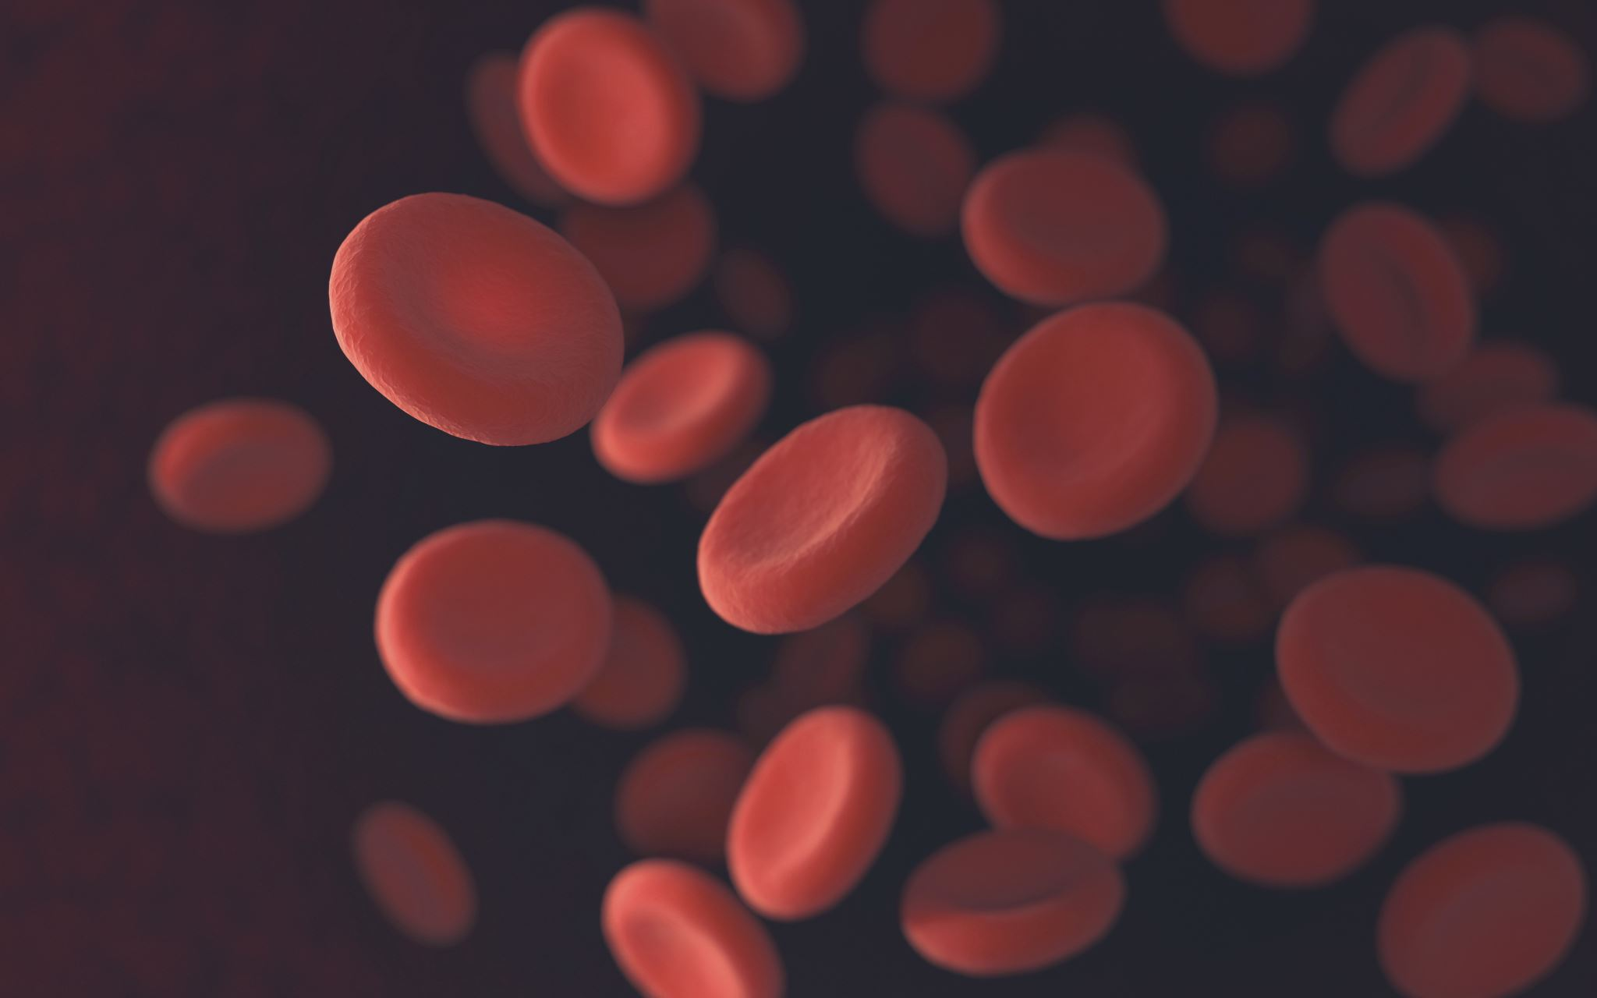
II. Blood conservation
Management of surgical bleeding to minimize intraoperative bleeding can be provided
Meticulous technique
Minimal invasive surgery
Reinfusion of shed blood
Topical hemosthatic/sealant agents
Electrocauter/coagulation, RF or Argon beam laser
Intraoperative cell salvage and ANH
Avoid/decrease blood transfusion (independent risk factor for respiratory complications, infection & ICU admission; twice risk with >2 U blood transfusion)
Reduce phelebotomy volume-blood loss (independent predictor of transfusion need)
Notes:
Hospital acquired anemia is observed two thirds of the hospitalized patients; anemia of chronic disease and phelebotomi induced blood loss are the contributing factors consecutively.

Slide 27
III. Optimization of coagulation 1.Assess coagulation status 2.Employ goal directed therapy 3.Assess true cause of bleeding 4.Consider rational use of FFP
Structured bleeding history
screening for bleeding disorders prior to surgery
Coagulation tests
aPTT/INR (1st line)
POC (TEG/ROTEM)
Protocols for discontinuation of anticoagulants
Rapid reversal of anticoagulation
FFP or 4F-PCC (FII, VII, IX, X)
Vit K
Notes:
Warfarine, asprin, clopidogrel, LMWH, Fxa inhibiotrs, direct thrombin inhibitors, herbal supplements etc.
Discontinuation only cannot be enough, bridging and rapid revrsal may be qrequired prior to emergency surgery.

Slide 28
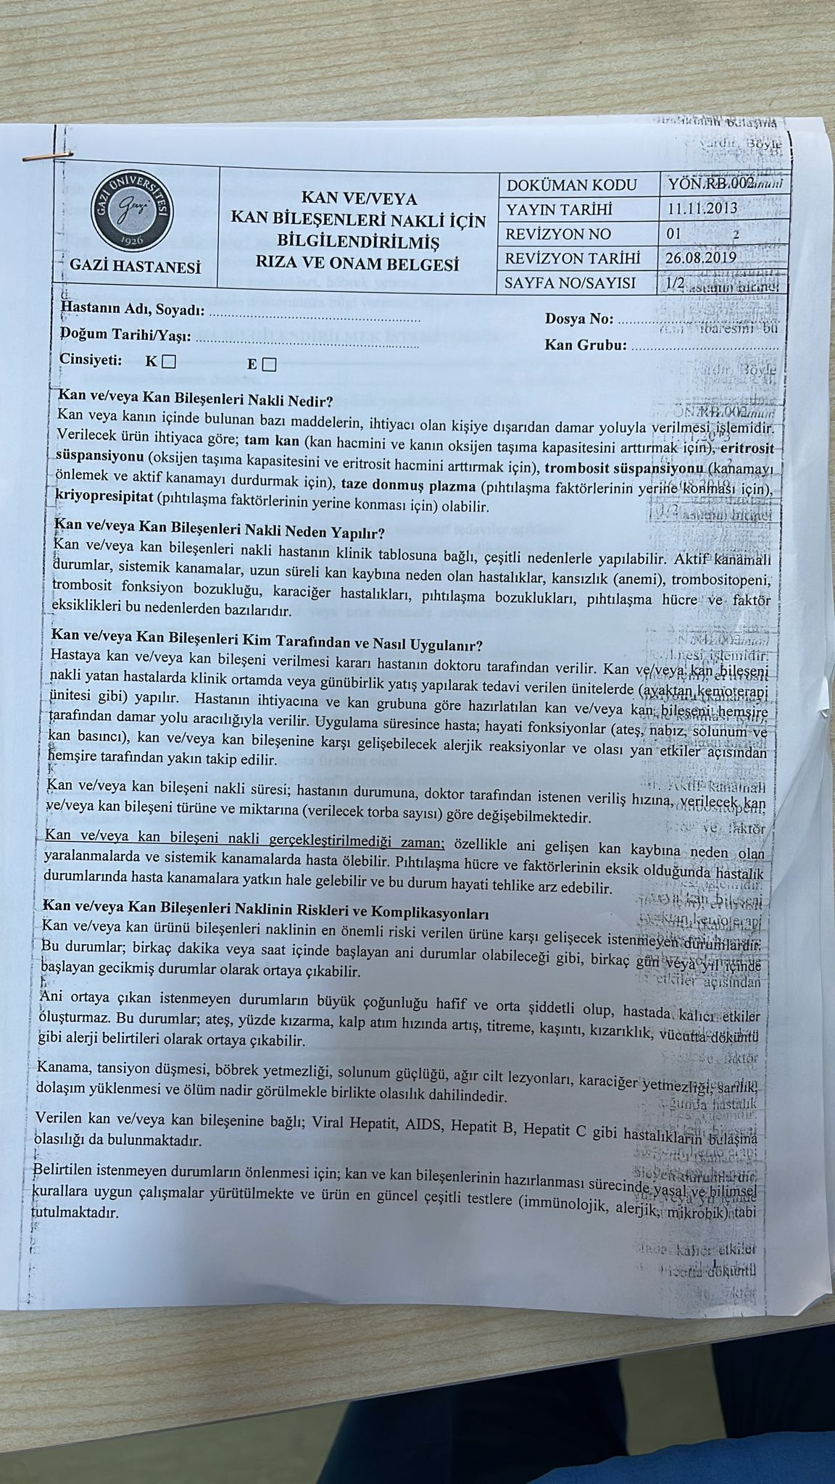
IV. Patient-centered decision making
Information about treatment, benefits and risks
Communication to tailor PBM approach due to specific religious and cultural factors
Written informed consent for transfusion
Obtaining a comprehensive informed consent with an open discussion between physician and patient is a vital component of patient centered decision making process
Notes:
Patients’ preferences, objectives and values

Slide 29
Comments
In order to improve patient care centered PBM, a comprehensive approach to the bleeding, coagulopathic, or anemic patient is suggested
Due to inappropriate RBC transfusion related increased morbidity and/or mortality, conservative over a liberal transfusion approach is recommended
Although paradigm shift from standard transfusion practice to PcBM has accelareted worldwide, being a gold standard might take time…

Slide 30
Obrigado!
Berrin Gunaydin
gunaydin@gazi.edu.tr

